Slide 2
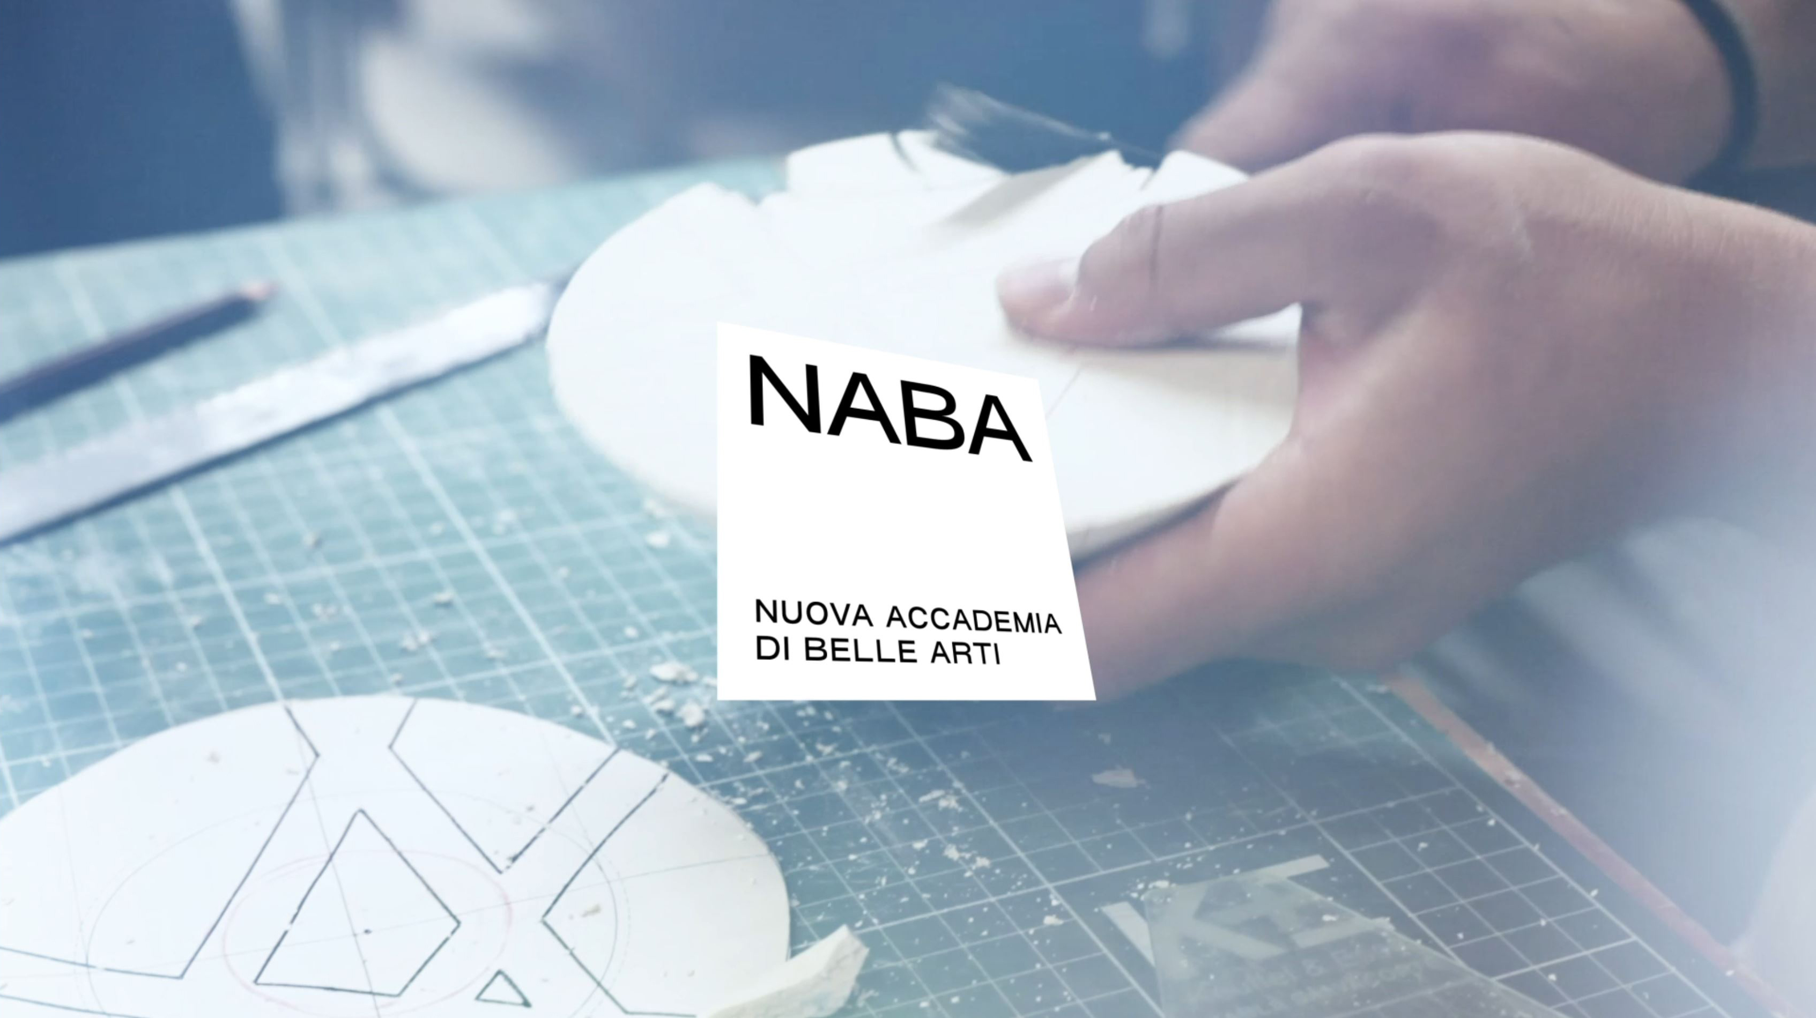

Slide 3
why
NABA
^{TO STUDY} | in Milan and Rome, the world capitals of Culture, Fashion, Art and Design |  | ^{TO ATTEND} | programmes in Italian and English and obtain a degree that is legally recognised by the Italian Ministry of University and Research (MUR), as well as at an international level.
^{TO COLLABORATE} | with companies and institutions in projects, internships and to benefit from many other opportunities.
 |  |  | ^{TO STUDY} | at a multi-awarded institution, named as the best Italian Academy of Fine Arts in the top 100 worldwide in Art & Design field in QS World University Rankings® by Subject.
^{TO GAIN} | a multidisciplinary, global, experimentation-oriented approach.
^{TO LEARN} | from prestigious faculty members and internationally renowned professionals.

Slide 4
STUDYING IN MILAN

Slide 5
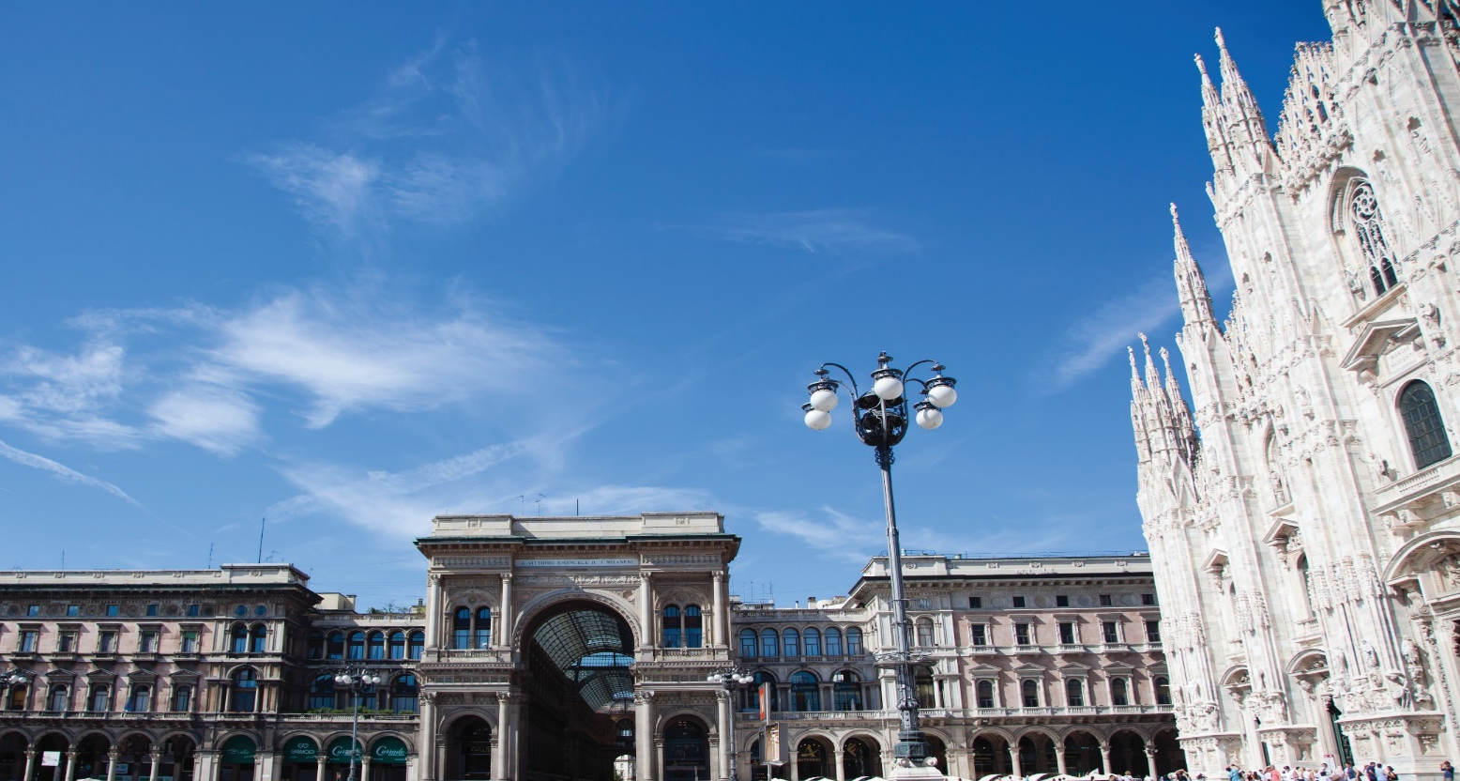
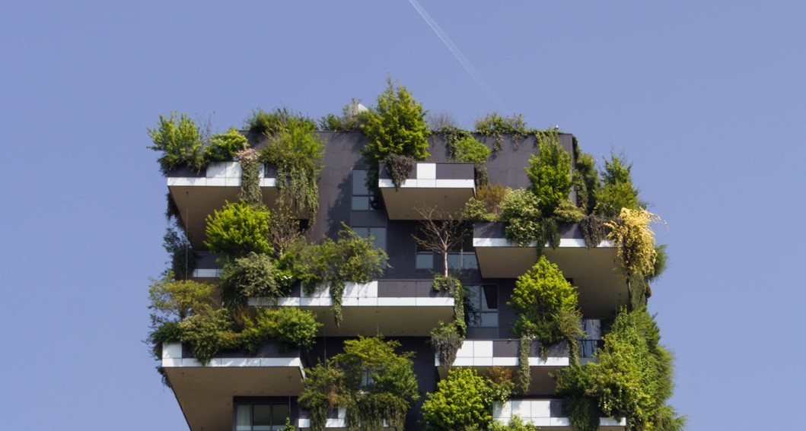
MILAN
The international capital
of Art, Fashion and Design

Slide 6
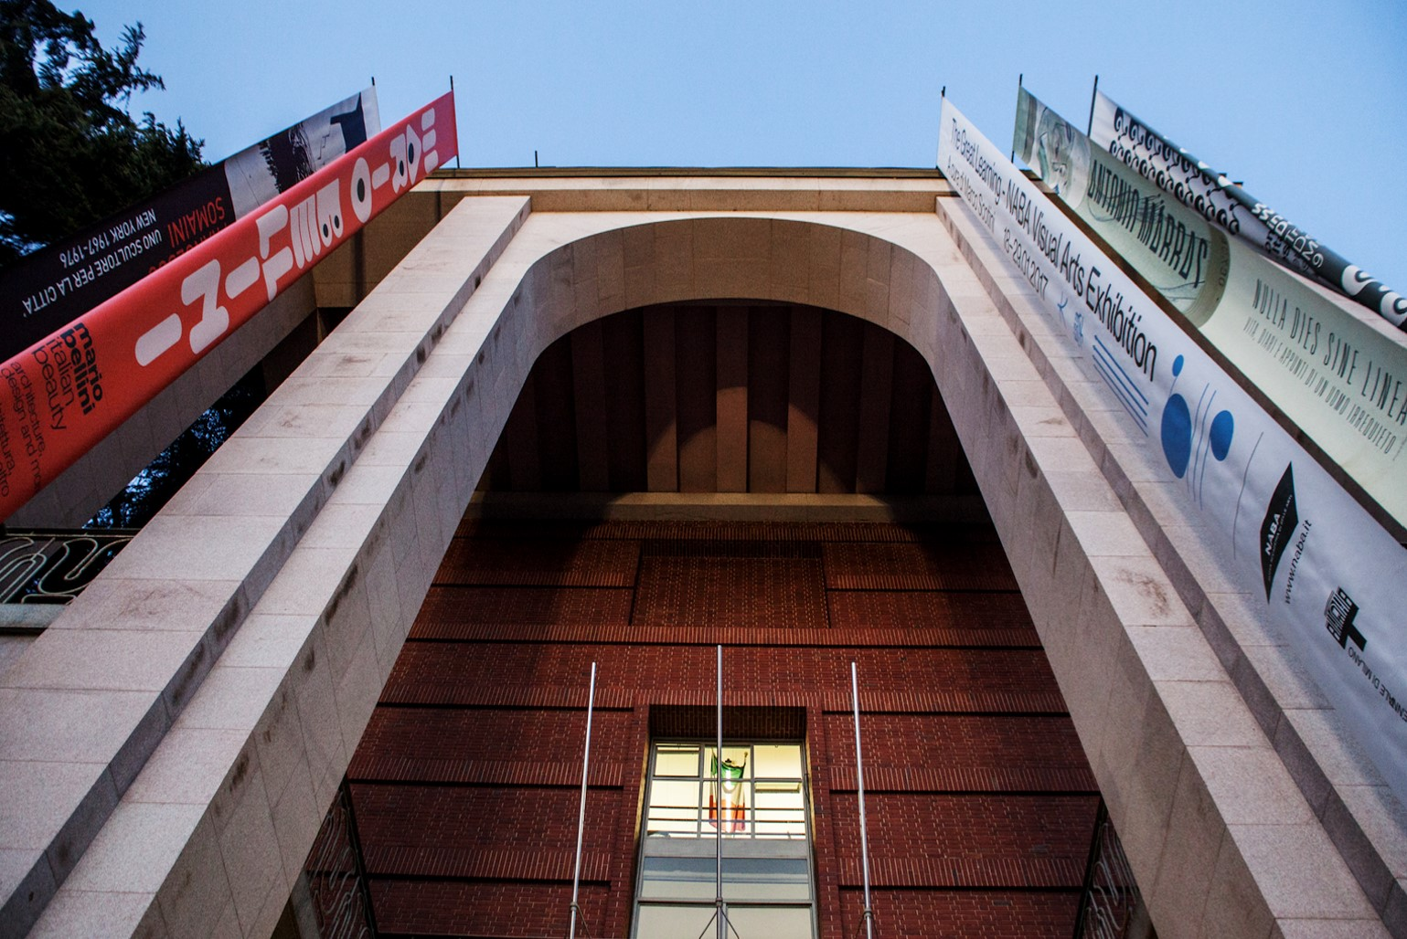
CITY
OF ARTS
Prestigious international institutions and cultural initiatives, from tradition to innovation

Slide 7
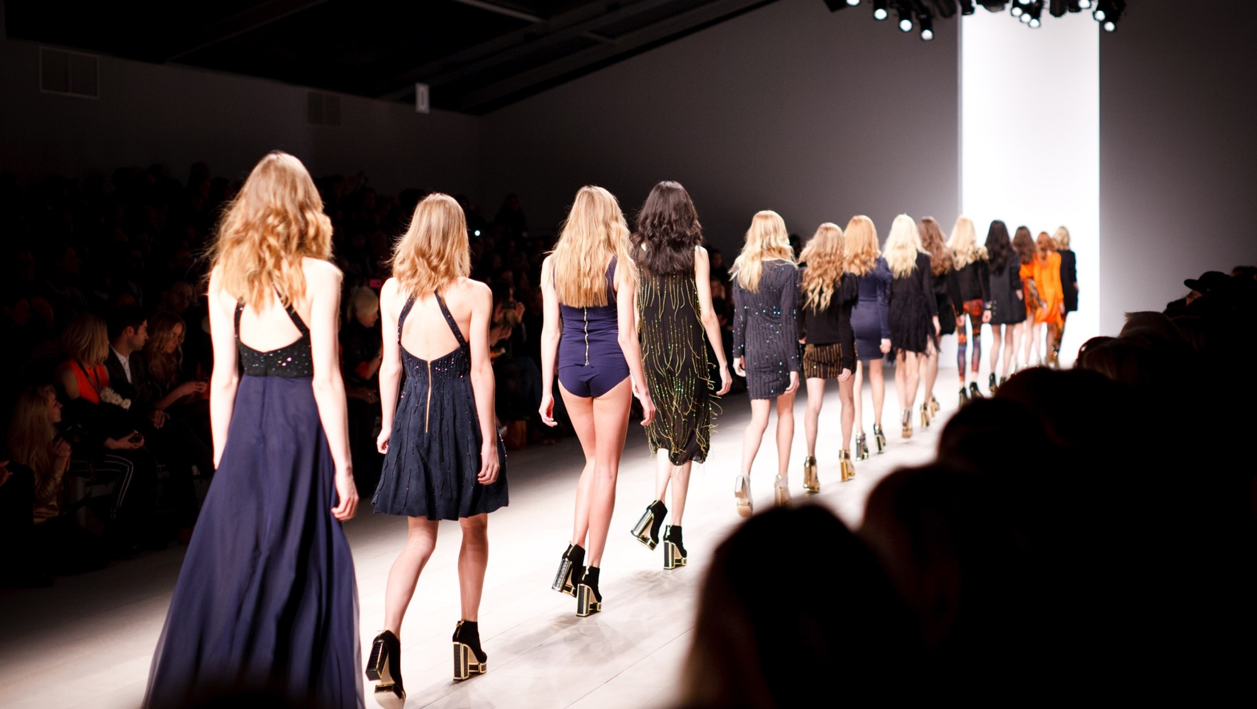
CITY
OF FASHION
The Fashion Weeks and the most famous fashion designers’ showrooms and studios

Slide 8
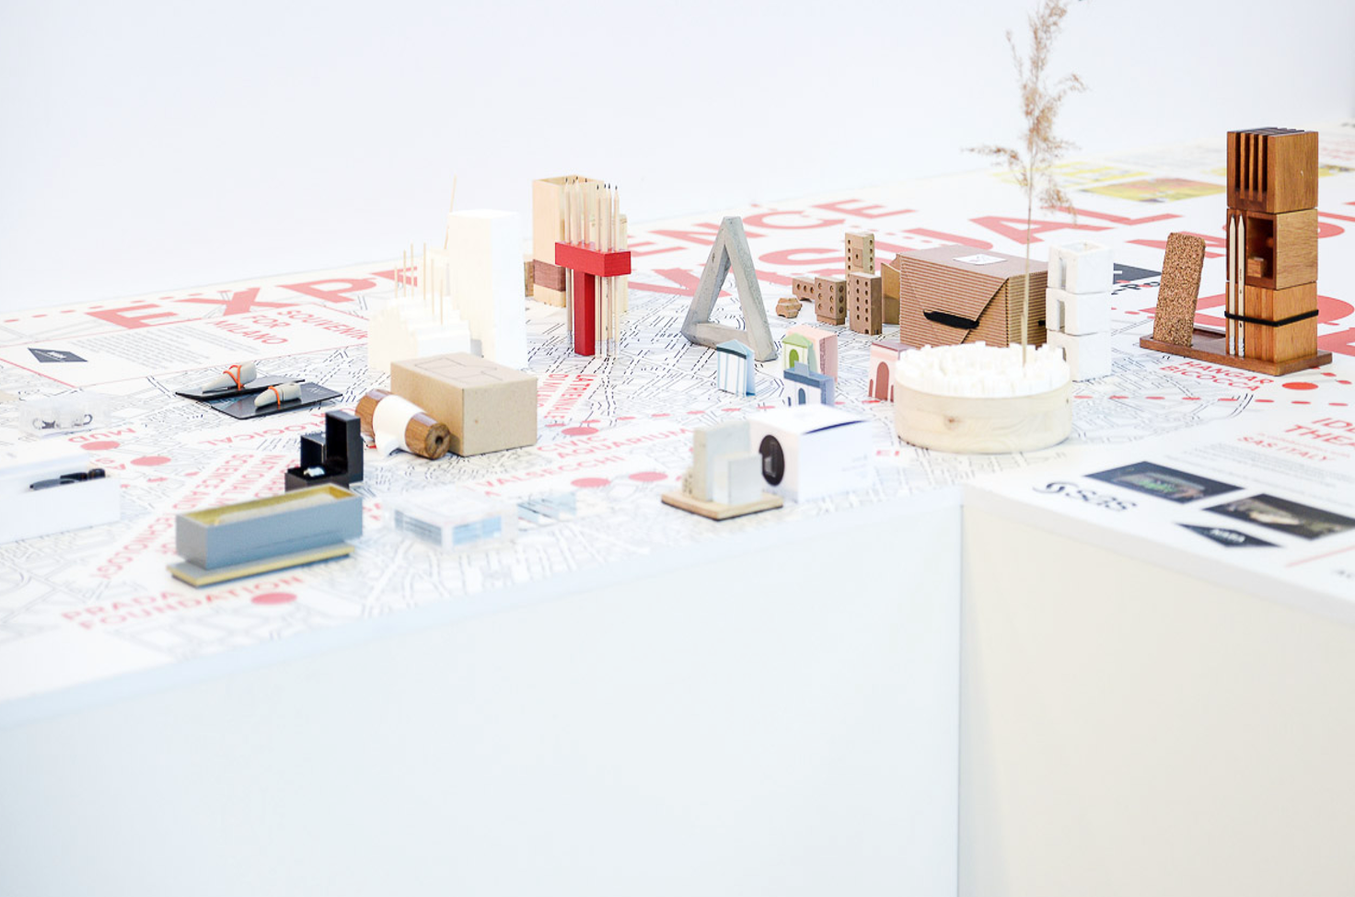
CITY
OF DESIGN
The International Design Week and hub of the most important design studios

Slide 9
STUDYING IN ROME

Slide 10
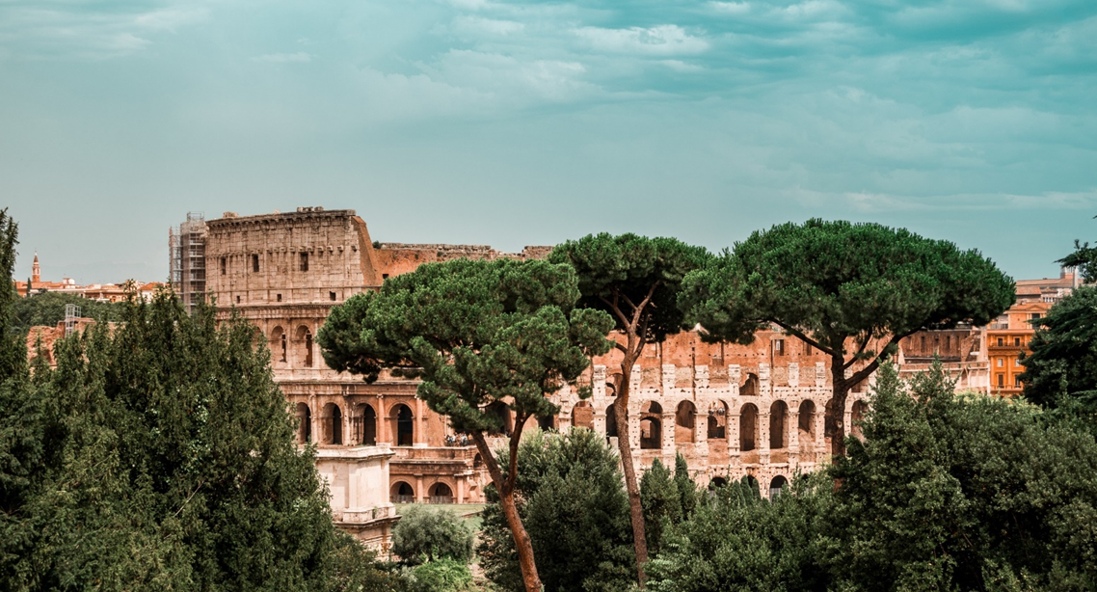
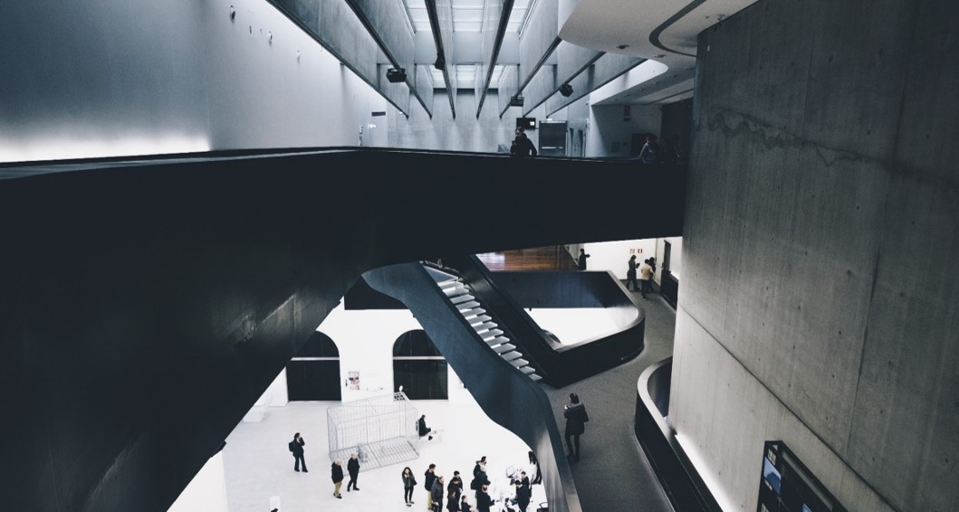
ROME
Eternal city of unique archaeological, historical and social heritage

Slide 11
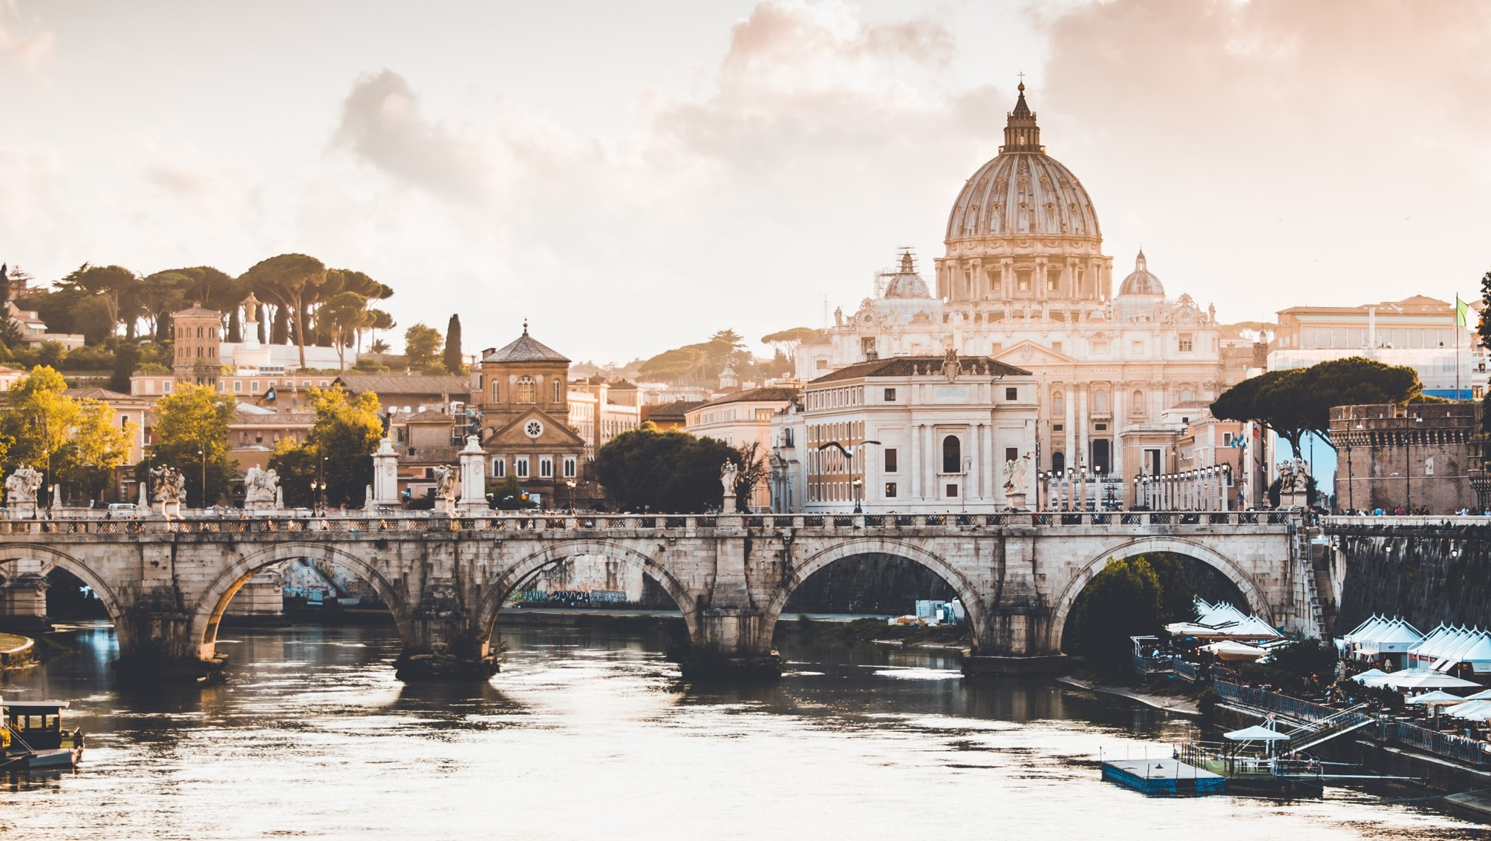
CITY
OF ARTS
The capital of Italian culture and cinema

Slide 12
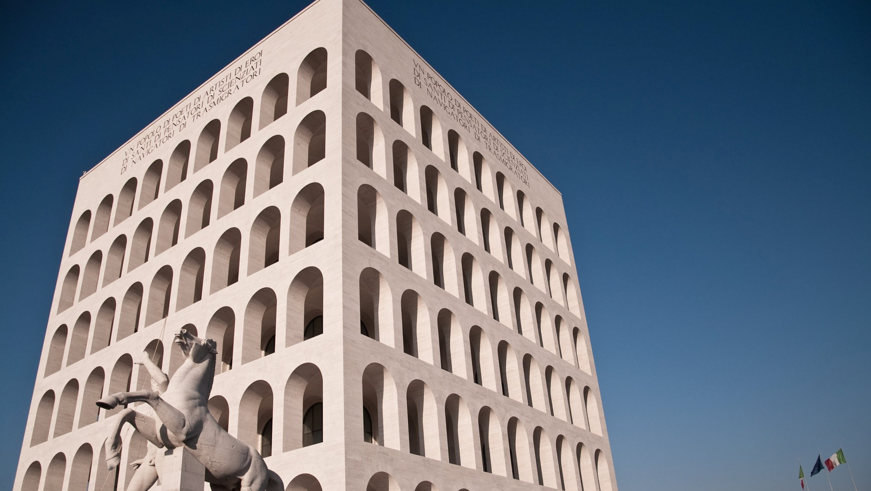
CITY
OF FASHION
Headquarter for important haute couture events and prestigious fashion brands

Slide 13
THE ACADEMY

Slide 14
NABA,
Nuova Accademia di Belle Arti
The largest Academy of Fine Arts in Italy
Founded in Milan in 1980 and recognised by Italian Ministry of University and Research (MUR), back in 1981
Innovative and multidisciplinary experiences in the artistic and professional context of current trends
Offers academic degrees equivalent to first and second level university degrees in the Communication and Graphic Design, Design, Fashion Design, Media Design and New Technologies, Set Design and Visual Arts Areas
First Academy of Fine Arts in Italy to introduce a fully practice-based Doctoral School
Special Programmes like Semester Abroad and Summer Courses
International exchange opportunities around
the world
Over 6,000 students coming from around 100 different countries

Slide 15


35% international students
100 nationalities represented

Slide 16
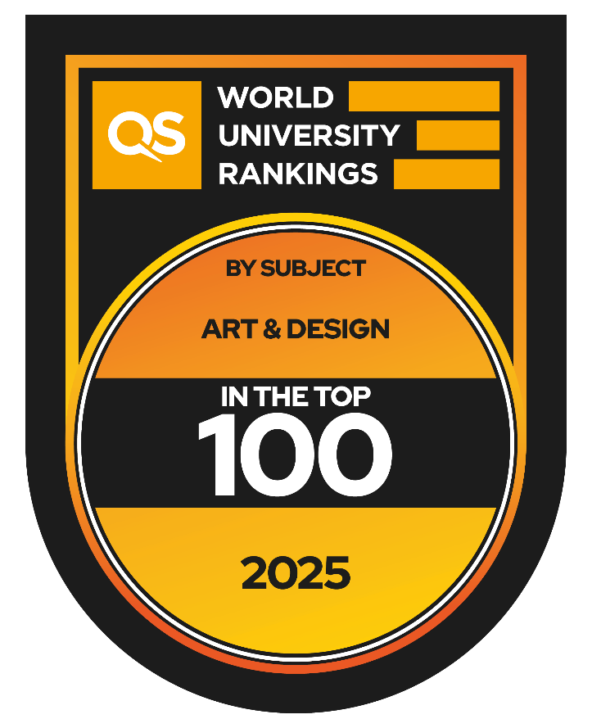
RECOGNITIONS
NABA has been named as the Best Italian Academy of Fine Arts in the top 100 worldwide in Art & Design field in QS World University Rankings® by Subject.
NABA BEST ITALIAN
ACADEMY
Among the TOP 100 universities worldwide
by Subject Art & Design

Slide 17
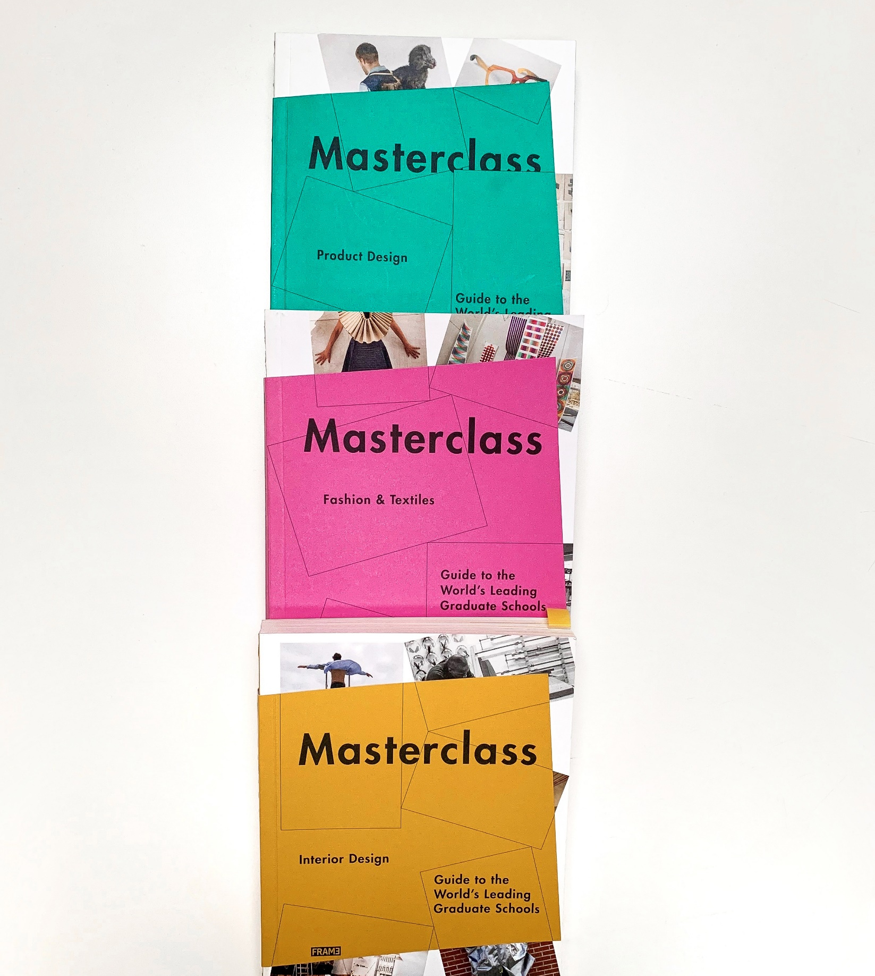
RECOGNITIONS
NABA was selected by FRAME Publisher in the guide to 30 World’s Leading Graduate Design and Fashion Schools
NABA was selected by Domus Magazine as one of the Europe’s Top 100 schools of Architecture and Design
NABA was ranked by BoF - Business of Fashion - Global Fashion School Ranking

Slide 18
NABA AWARDS In over 40 years of history, numerous awards and accolades credited NABA as a prominent institution at national and international level, thanks to the extraordinary work of its students and faculty, among others:
AccadeMibact - MiBACT and La Quadriennale di Roma ADCI Awards - Art Directors Club Italiano ADI Design Index ADI - Targa Bonetto, Targa Giovani e Menzione d’Onore Alice nella città - Independent and parallel section of the Rome Film Festival A Shaded View On Fashion Film (ASVOFF) Cantica21 (Italian Contemporary Art Everywhere) promoted by MAECI and MiBACT D&AD New Blood Awards DECO - Design Competition Condivisione Digital Innovation Days Italy EPDA - European Brand & Packaging Design Association Erasmus+ KA210 Filmmaker Festival James Dyson Award Jumpthegap Roca International Design Contest Imago Mundi - Benetton International Lab of Mittelmoda - Fashion Award: Absolute Prize Creativity - Camera Nazionale della Moda Italiana e Knitwear Prize - Benetton Group ISKO I-SKOOL For more Prizes and Awards please visit www.naba.it | MAXXI BVLGARI PRIZE Milano Moda Graduate - Camera Nazionale della Moda Italiana MM Award – International creative award Nastri d'Argento Olivetti Design Contest Pini Art Prize Première Vision PNA, Premio Nazionale delle Arti – Ministero dell’Università e della Ricerca (MUR) Premio Nazionale Franco Enriquez Premio Scenario Short Italian Cinema at Settimana Internazionale della Critica during the Venice International Film Festival Student Award, Milano Design Film Festival Student World Impact Film Festival Milano Design Film Festival The Young Ones - The One Club for Creativity Torino Film Festival UNTAGGED GFW23 Catwalk Show, Londra (UK) – promoted by Graduate Fashion Week International Who is On Next? Altaroma in collaboration with Vogue Italia WPP Talent Award

Slide 19
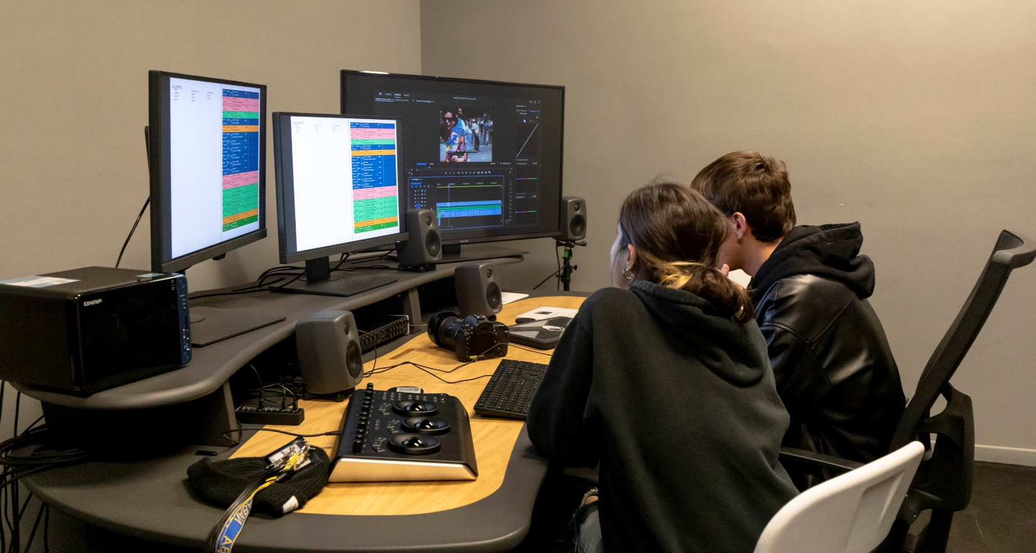
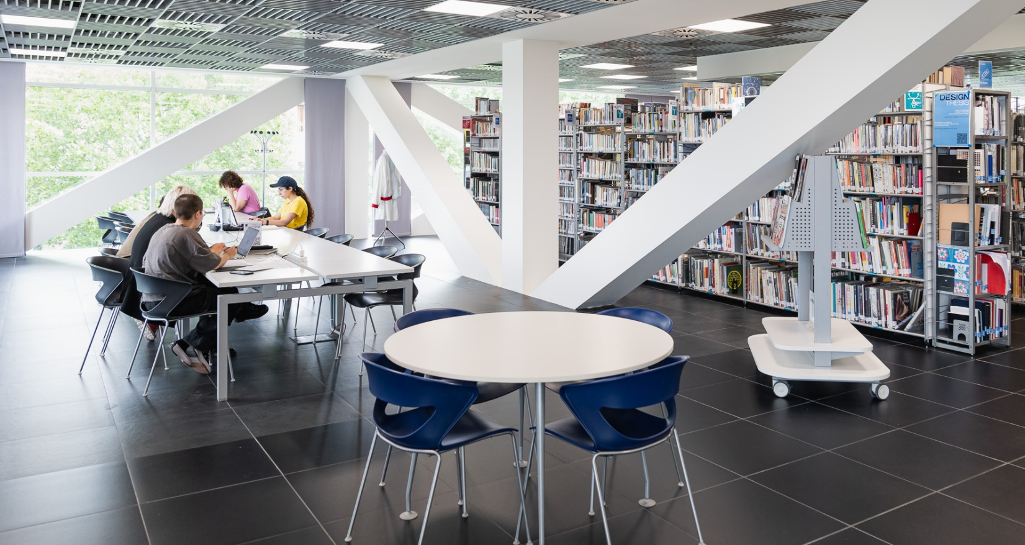
NABA CAMPUS
The two NABA campuses, in Milan and Rome, cover a total area of 60,000 square meters, occupying overall 18 buildings with over 50 specialised labs.
NABA’s campus in Milan is located near the Navigli area, one of the liveliest parts of the city, and includes students’ study and lounge areas, a green area, several specialised laboratories, a library and a cafeteria.
The campus in Rome is located in historical buildings of early 20th century in the Ostiense district, where the artistic and cultural heritage meets contemporary culture. The campus includes specialised laboratories, a library, study and lounge areas, a terrace and a green area as well as multifunctional spaces.

Slide 20
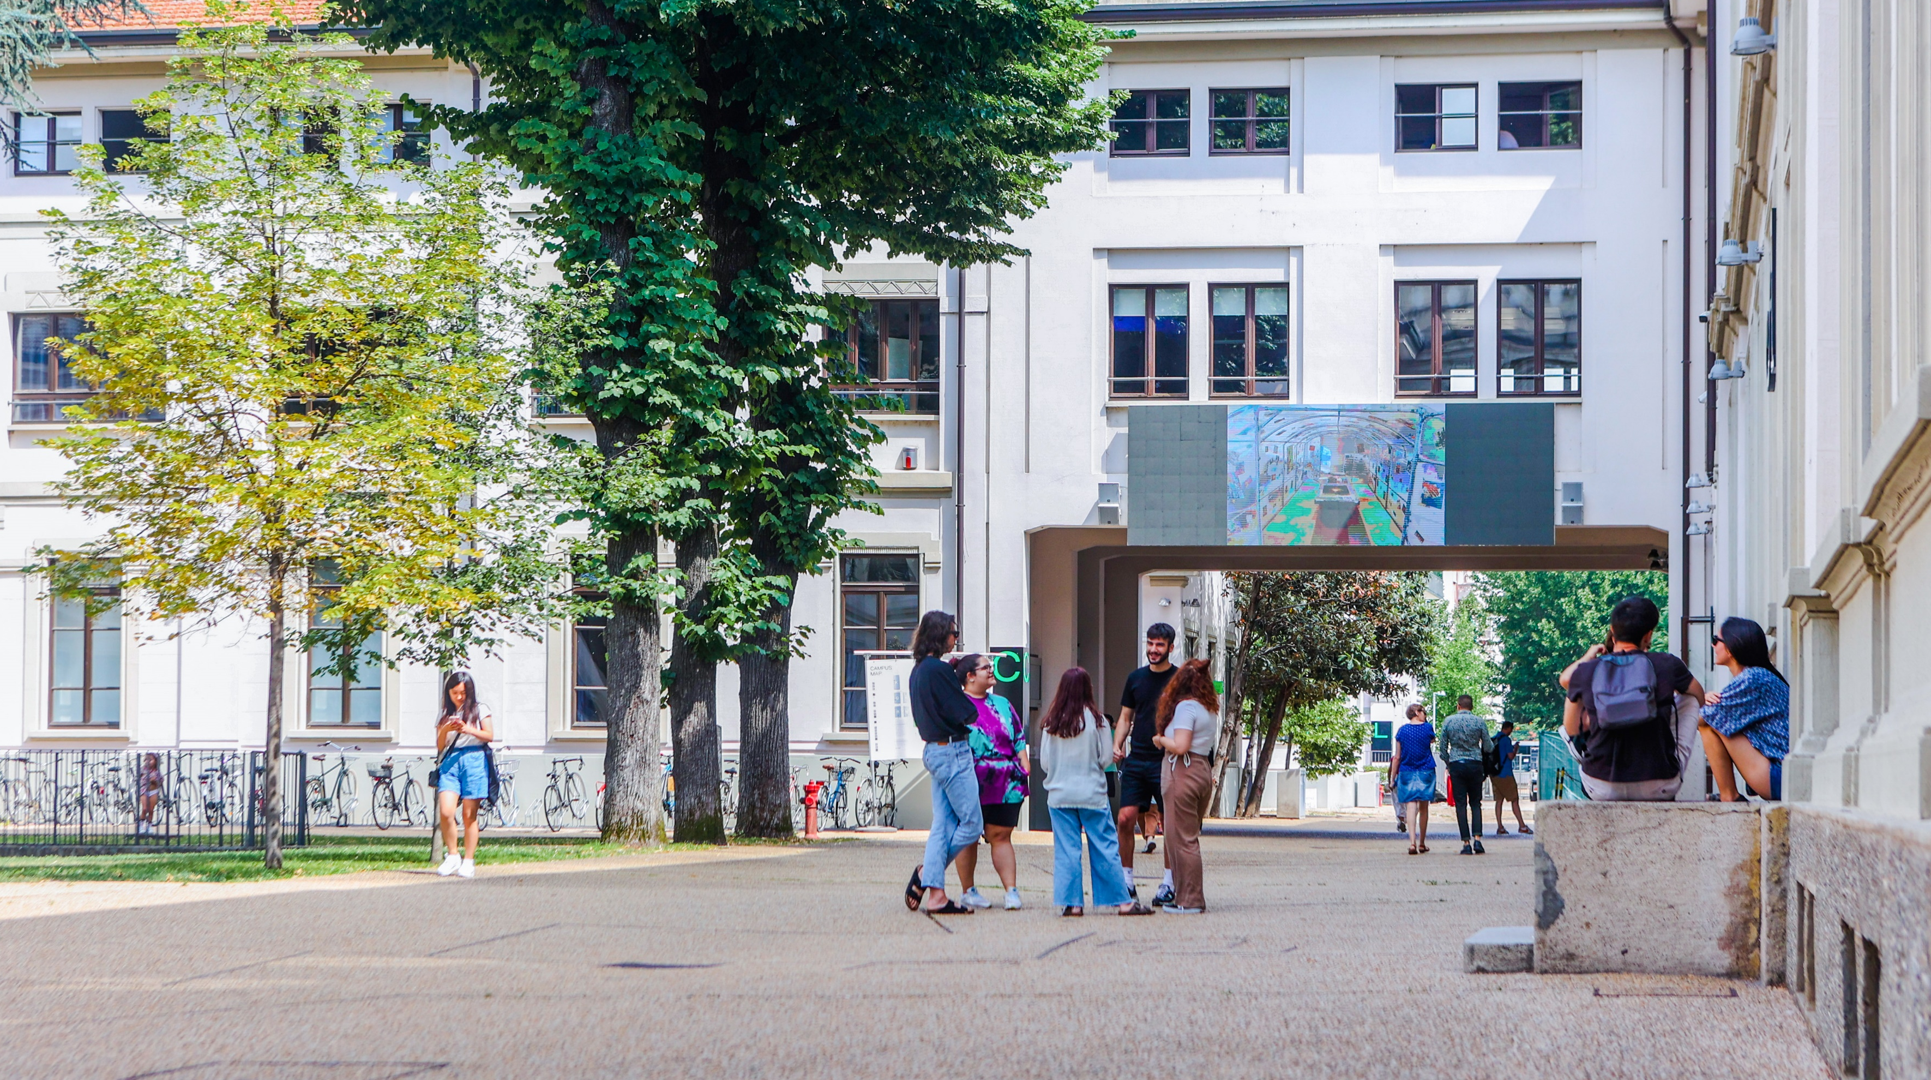
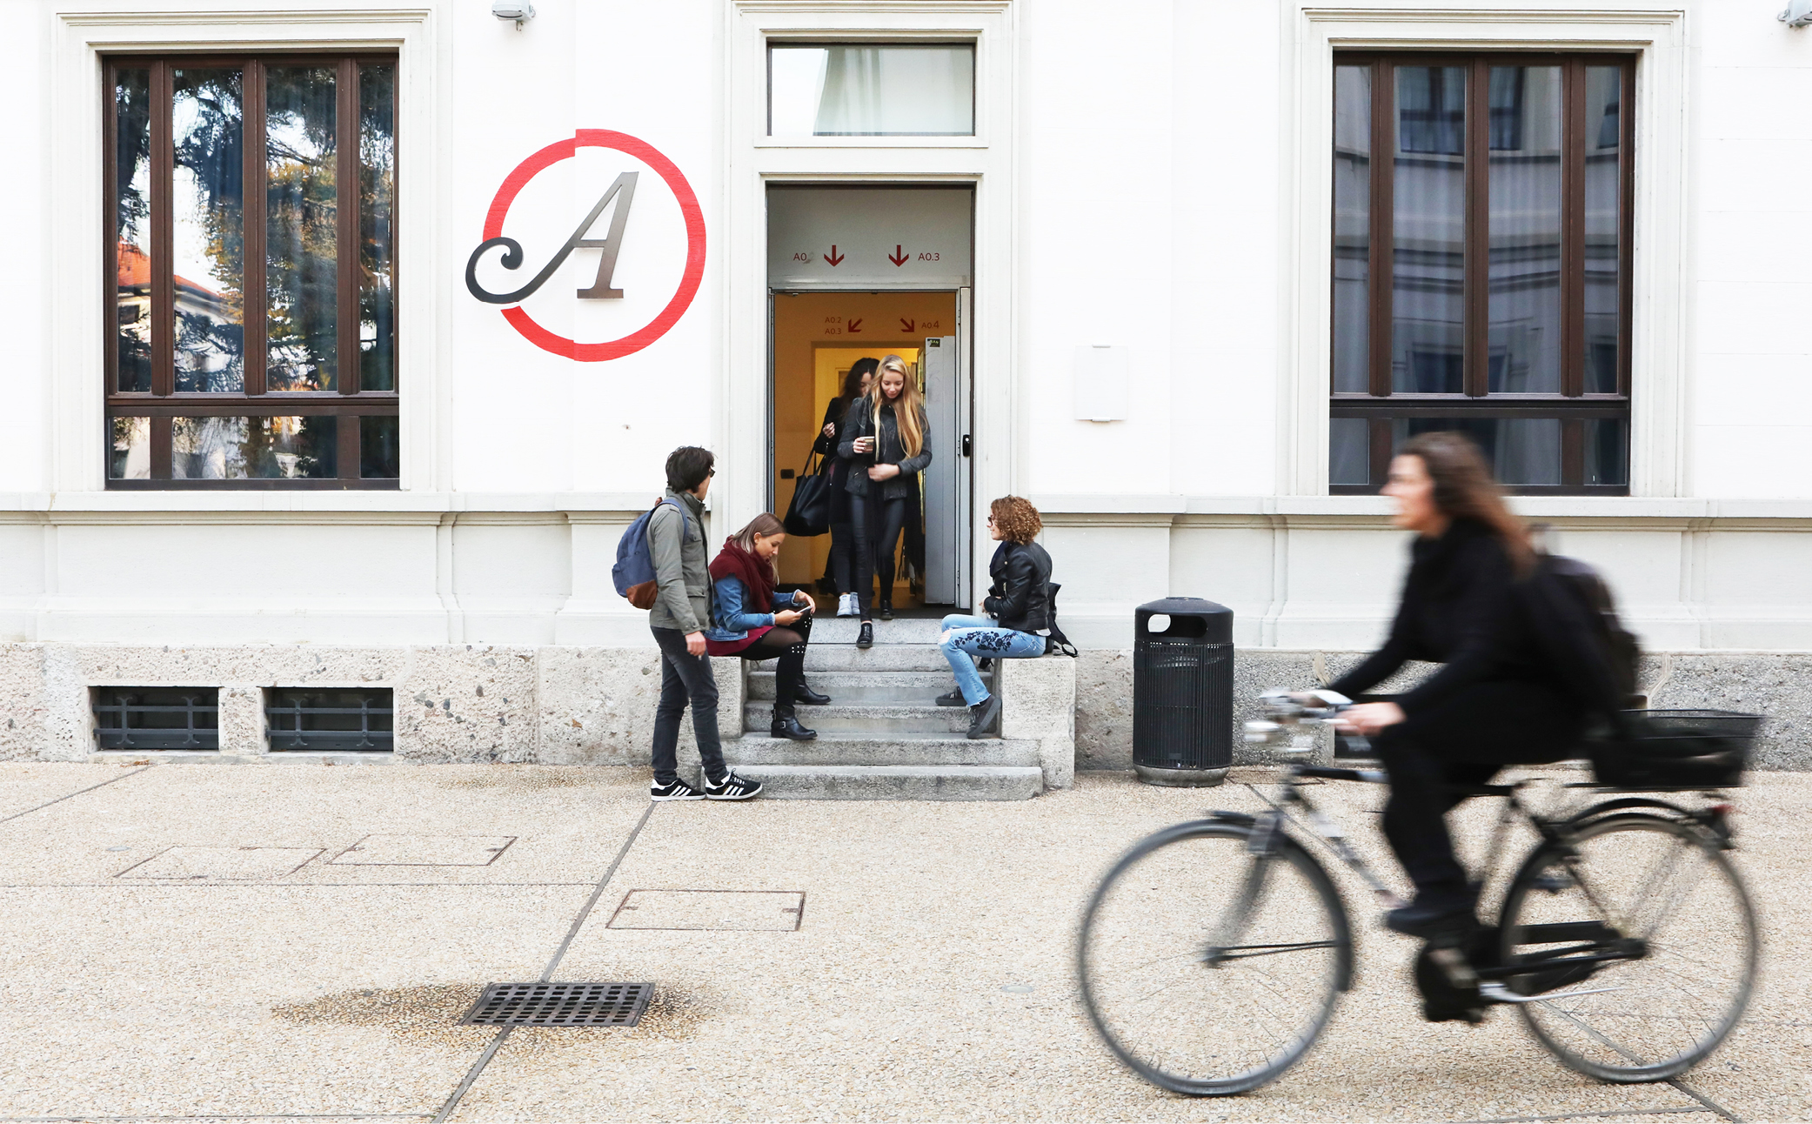
NABA campus in Milan

Slide 21
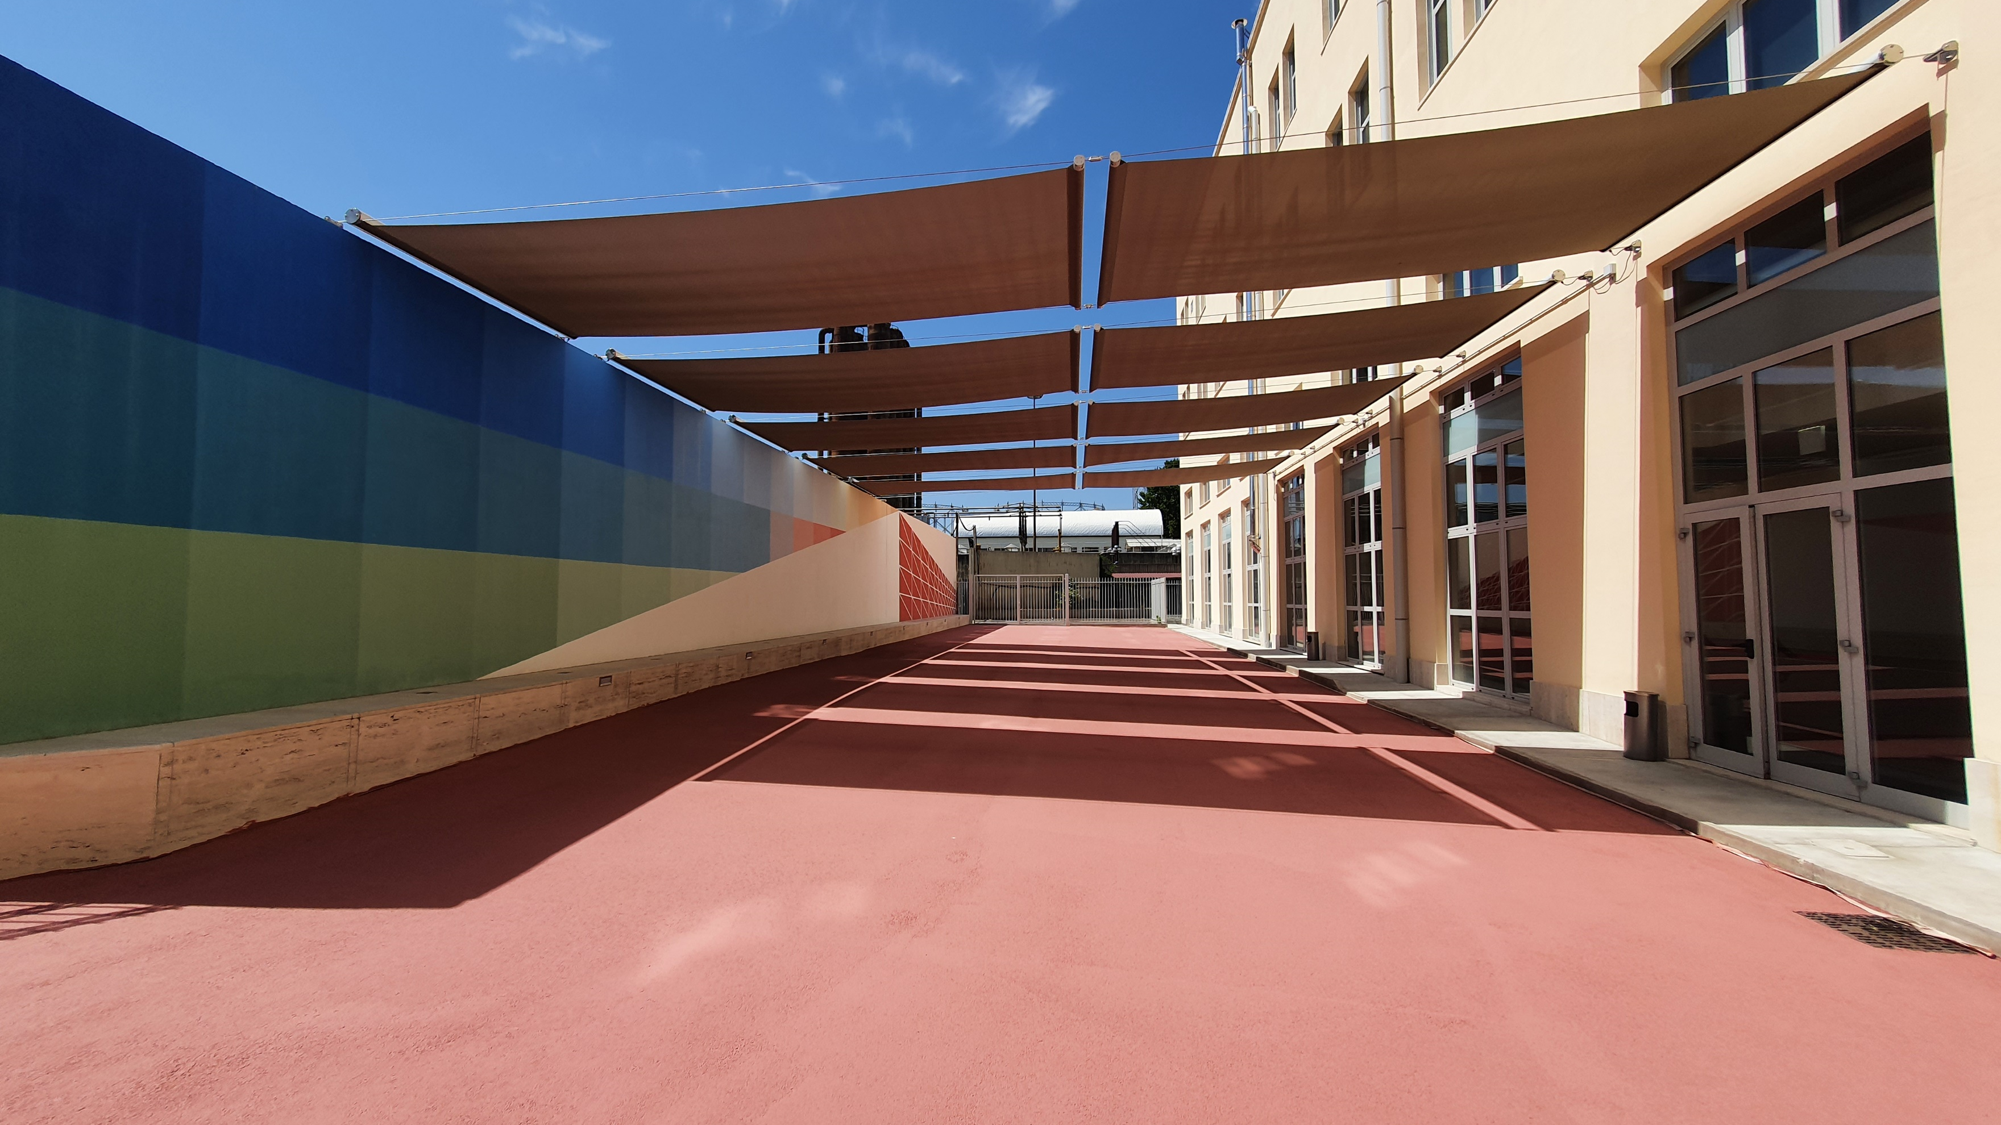
NABA campus in Rome

Slide 22
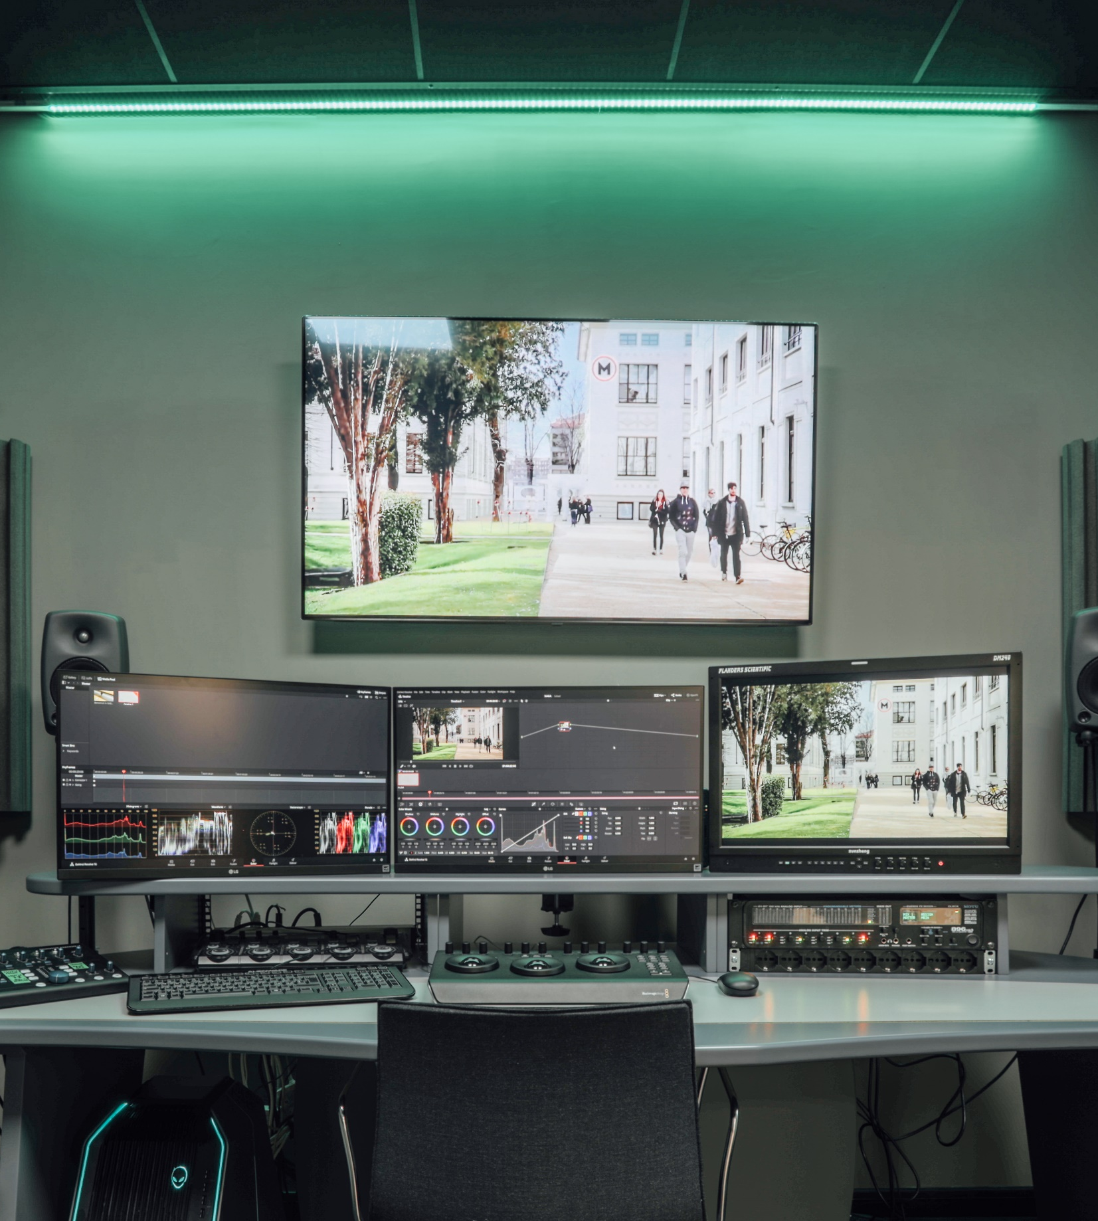
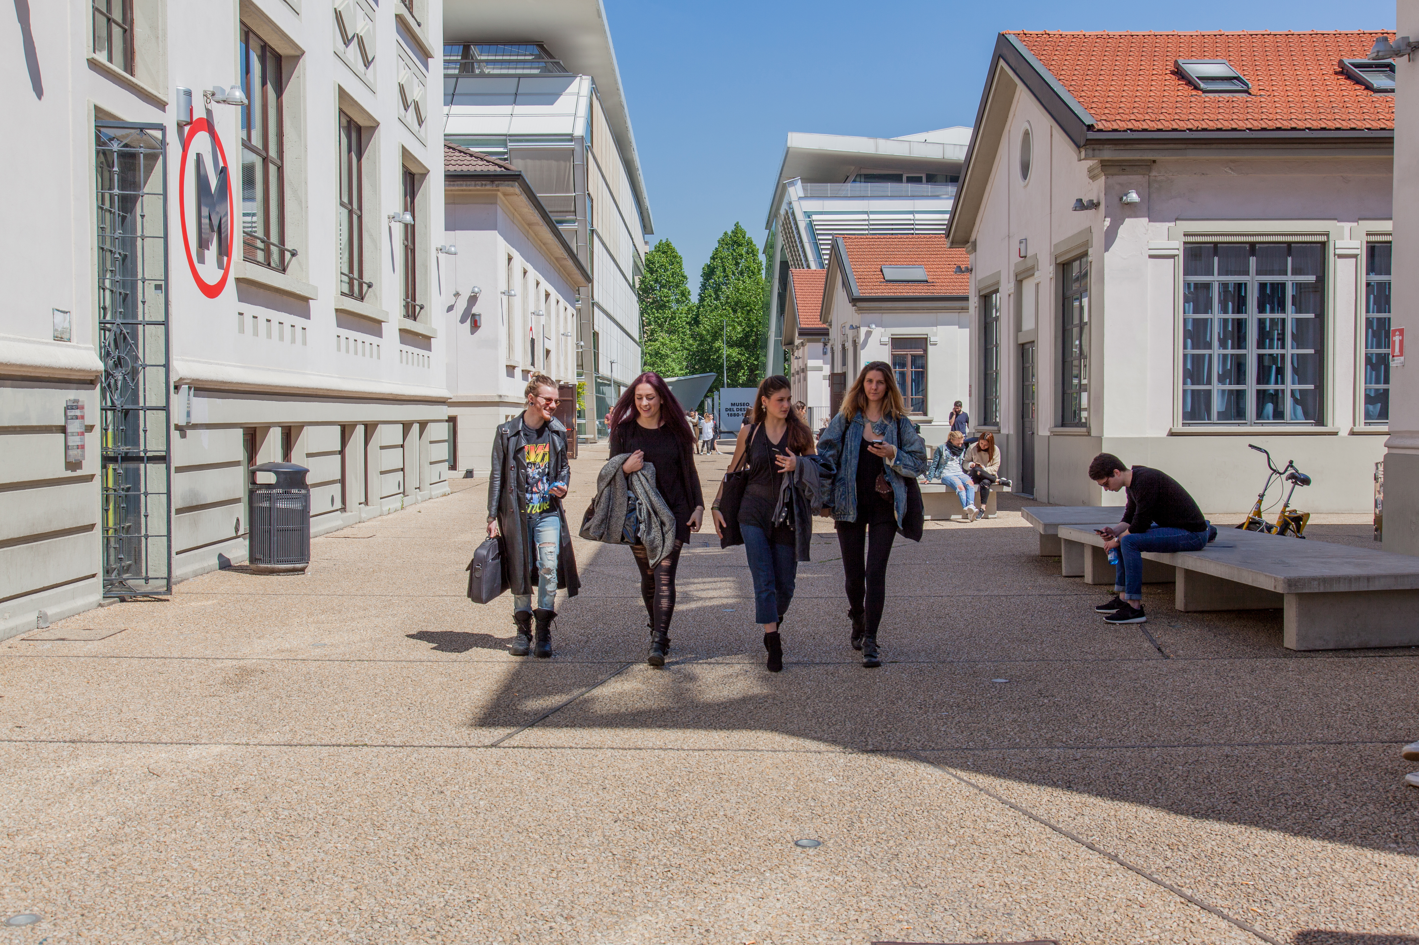
LABORATORIES
NABA has numerous specialised laboratories directed at providing students with the professional tools to create complex and interdisciplinary projects, among them:
Design and Set Design Labs with Laser Cut, 3D Printer, Clay 3D Printer, CNC milling machine, wood and plastic processing machines, painting booth, thermoforming machines, professional chamber kiln for firing
Fashion Design and Knitting Labs with industrial sewing machines, presses, irons and racks, mannequins and professional machinery systems including Lectra, Shima Seiki and Framis
Textile Library for research and study of fabrics
Orto Tintorio to cultivate dyeing plants for textile design
Film and Photo Studio Labs, Green Screen, Ciclorama, VFX, 2D-3D Animation, Virtual/Augmented Reality tools, Video Games and Audiovisual Production, Photo Shootings environments
A laboratory dedicated to Virtual Production, the Virtual Studio, with a Led Volume and an advanced Motion Capture sysem
Visual Arts Labs (Atelier), Chalcographic engraving spaces, Darkroom
Coming soon: Set Design Lab, Graphic Design Lab, Sneaker Design Lab

Slide 23
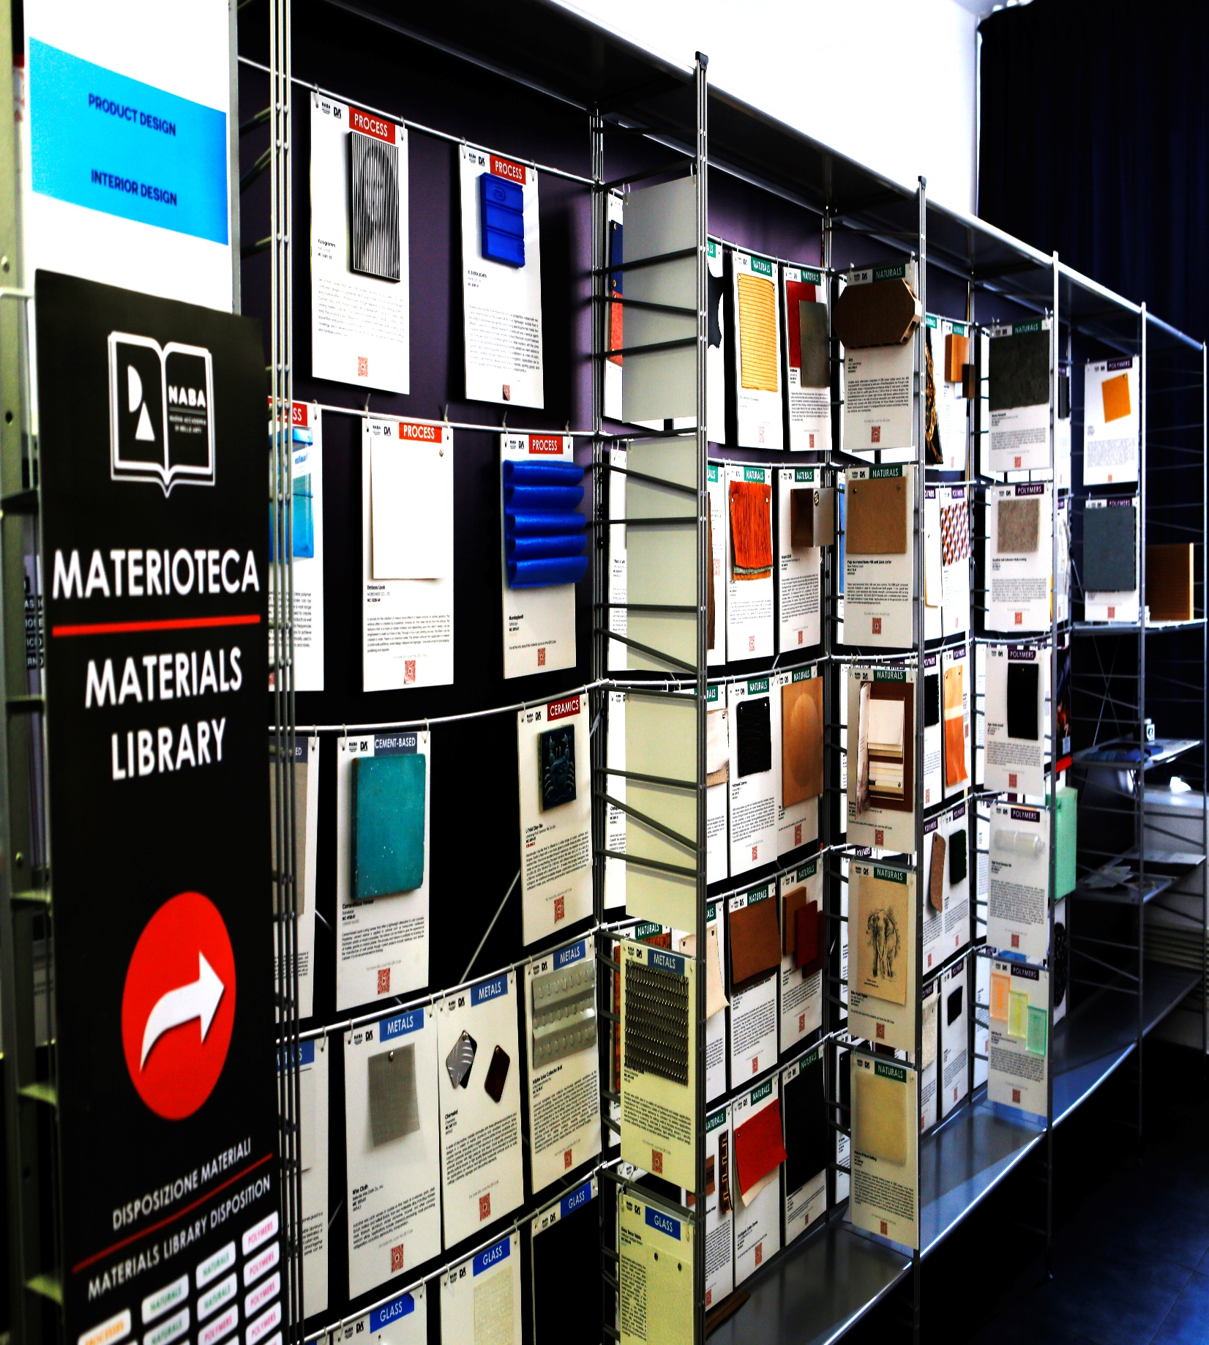
MAIN
SERVICES
      Free wi-fi
      Student computer rooms
      Library
      Study, lounge and dining areas
      Career service
      Housing service
      Student life service

Slide 24
ACADEMIC OFFER

Slide 25
ACADEMIC OFFER A.Y. 2025/26
BACHELORS OF ARTS 180 CFA (1CFA=1ECTS) | COMICS AND VISUAL STORYTELLING (Italian-English / Milan-Rome) GRAPHIC DESIGN AND ART DIRECTION (Italian-English / Milan-Rome) DESIGN (Italian-English / Milan-Rome) FASHION DESIGN (Italian-English / Milan-Rome) FASHION MARKETING MANAGEMENT (Italian-English / Milan-Rome^{NEW!}) CREATIVE TECHNOLOGIES (Italian-English / Milan) FILM AND ANIMATION (Italian-English / Milan-Rome) SET DESIGN (Italian-English / Milan) PAINTING AND VISUAL ARTS (Italian-English / Milan-Rome)
MASTERS OF ARTS 120 CFA (1CFA=1ECTS) | USER EXPERIENCE DESIGN (Italian-English / Milan) VISUAL DESIGN AND INTEGRATED MARKETING COMMUNICATION (Italian-English / Milan-Rome) INTERIOR DESIGN (Italian-English / Milan) PRODUCT AND SERVICE DESIGN (Italian-English / Milan) SOCIAL DESIGN (English / Milan) FASHION AND COSTUME DESIGN (Italian-English / Rome) FASHION DESIGN (Italian-English / Milan) TEXTILE DESIGN (Italian-English / Milan) CREATIVE MEDIA PRODUCTION (Italian-English / Milan) DIGITAL AND LIVE PERFORMANCE (Italian-English / Milan) VISUAL ARTS AND CURATORIAL STUDIES (Italian-English / Milan-Rome)
The programmes and topics indicated in this presentation may undergo variations due to academic or ministerial reasons. For all the updates on didactic news: www.naba.it

Slide 26
ACADEMIC OFFER A.Y. 2025/26
ACADEMIC MASTERS 60 CFA (1CFA=1ECTS) | CREATIVE ADVERTISING (English / Milan) LUXURY BRAND MANAGEMENT^{NEW!} (Italian-English / Milan) SUSTAINABLE INNOVATION COMMUNICATION (English / Milan) INTERIOR AND LIVING DESIGN^{NEW!} (Italian-English / Milan) ITALIAN DESIGN (English / Milan) NEW URBAN DESIGN (English / Milan) FASHION DIGITAL MARKETING (Italian-English / Milan) SNEAKER DESIGN^{NEW!} (Italian-English / Milan) SCREENWRITING FOR SERIES (English / Rome) ART AND ECOLOGY (English / Milan) CONTEMPORARY ART MARKETS (Italian-English / Milan) PHOTOGRAPHY AND VISUAL DESIGN (Italian-English / Milan)
RESEARCH DEGREES | PHD IN ARTISTIC PRACTICE (English / Milan) PHD IN ARTISTIC PRACTICES AND DESIGN CULTURE^{NEW!} (Italian / Milan)
OTHER PROGRAMMES | Semester Abroad Programmes / Summer Courses / Diploma Programmes / Erasmus+ and International Exchange / Foundation Course / Corsi Brevi (Short Courses) / Gap Year Programme
The programmes and topics indicated in this presentation may undergo variations due to academic or ministerial reasons. For all the updates on didactic news: www.naba.it

Slide 27
BACHELORS OF ARTS

Slide 28
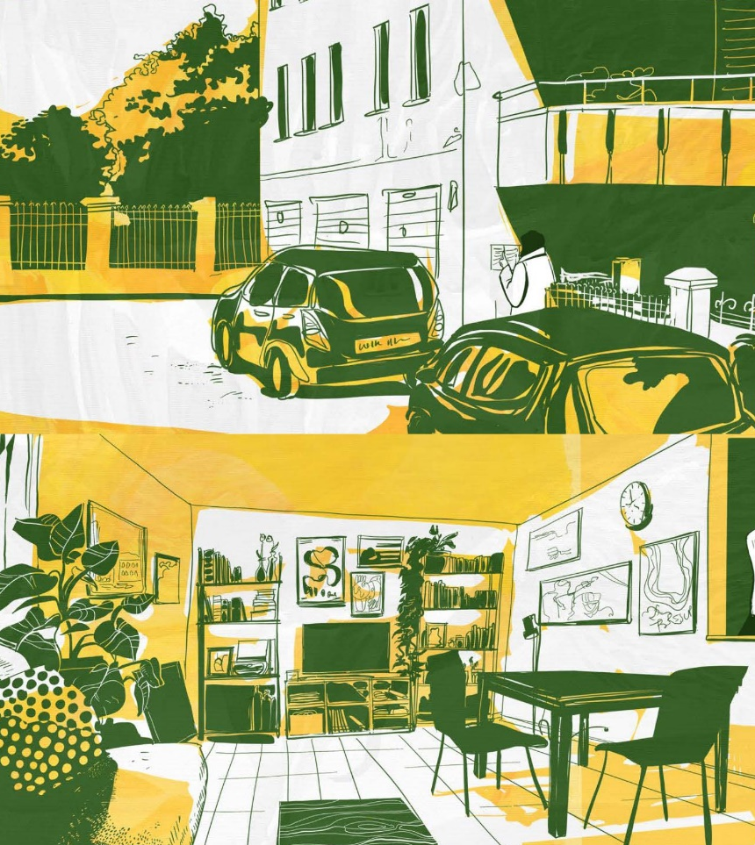
Bachelor of Arts in
COMICS AND VISUAL STORYTELLING
Campus
Milan – Rome
The BA in Comics and Visual Storytelling (First Level Academic Degree in Graphic Design and Art Direction) prepares future comics illustrators, graphic novelists and visual artists providing them with the necessary skills to create engaging stories and develop their own style. By studying various genres - from Superheroes to Manga, from Mickey Mouse to the Comic Strips, from Indie Comics to Visual Novels, as well as the art of visual storytelling, students will learn the basic principles of comics, enabling them to create narratives, characters and visual sequences capable of conveying messages and emotions.

Slide 29

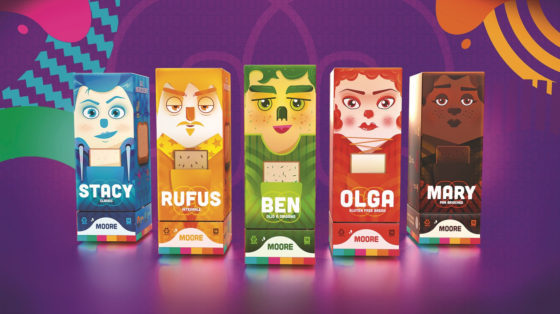
Bachelor of Arts in
GRAPHIC DESIGN
AND ART DIRECTION
Specialisations
Brand Design
Creative Direction
Visual Design
Campus
Milan – Rome
This BA guides students into the varied world of communication, a dynamic and ever-expanding sector, as are its possible professional applications. With its three main specialisations – Brand Design, Creative Direction and Visual Design – the BA offers an interdisciplinary programme tackling several fields, from graphic design, advertising, publishing, motion graphic and 3D modelling, web design and UX/UI, to generative applications of Artificial Intelligence. The students also participate in real briefs’ design in collaboration with both national and international partners, through the experimental activity of the creative workshop.

Slide 30
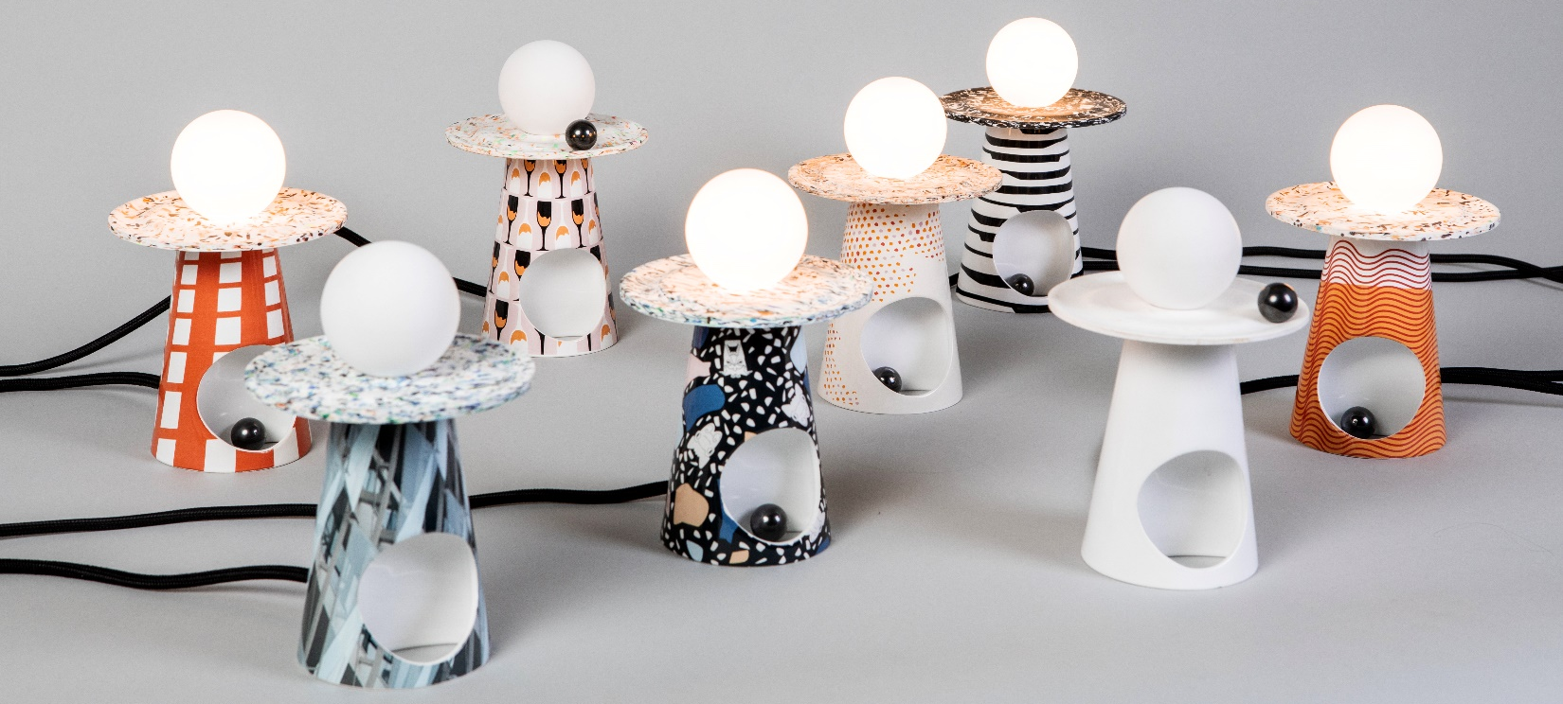
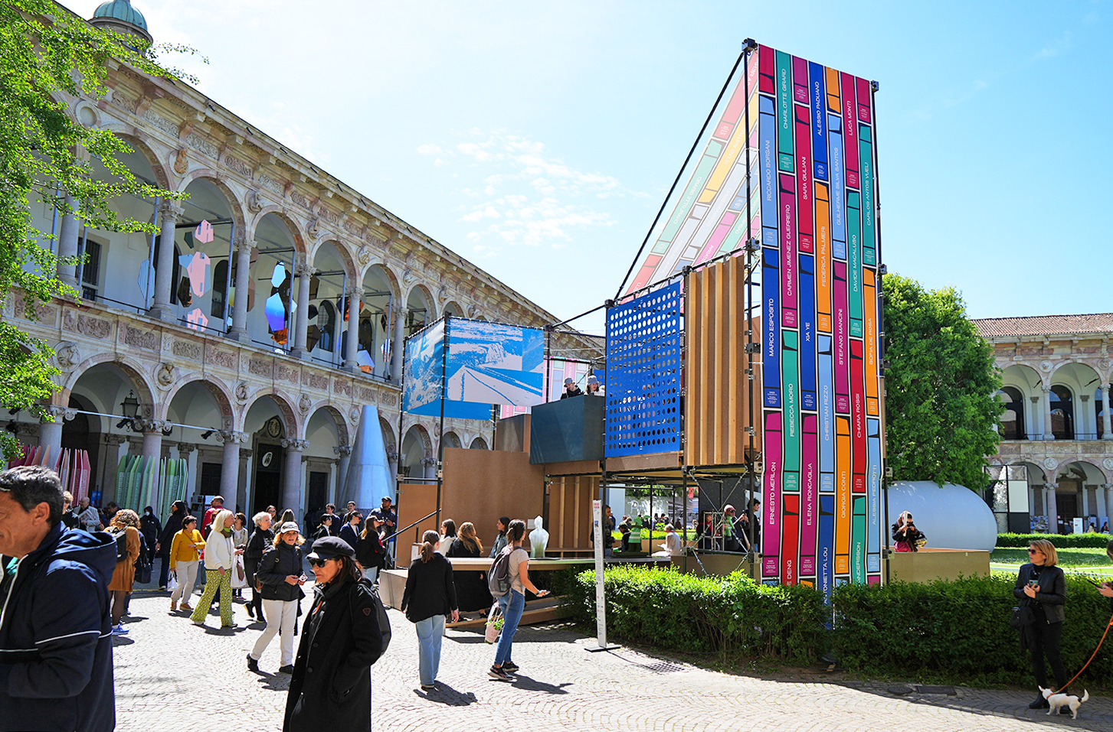
Bachelor of Arts in
DESIGN
Specialisations
Interior Design ^{MILAN - ROME}
Product Design ^{MILAN}
Product and Innovation Design ^{ROME}
Campus
Milan – Rome
Following the “learning by doing” approach, the BA sees a mix of theoretical and practical activities; the course includes workshops to integrate both. After having explored basic concepts and techniques, students learn to observe the multitude of contemporary forms of design and how to apply them to their work. The course aims at stimulating sensitivity and passion for the world of objects, understood as cultural artefacts that reflect and shape human life. It explores space as an environment, examining its interactions with objects and its function as a stage for individual and collective rituals.

Slide 31
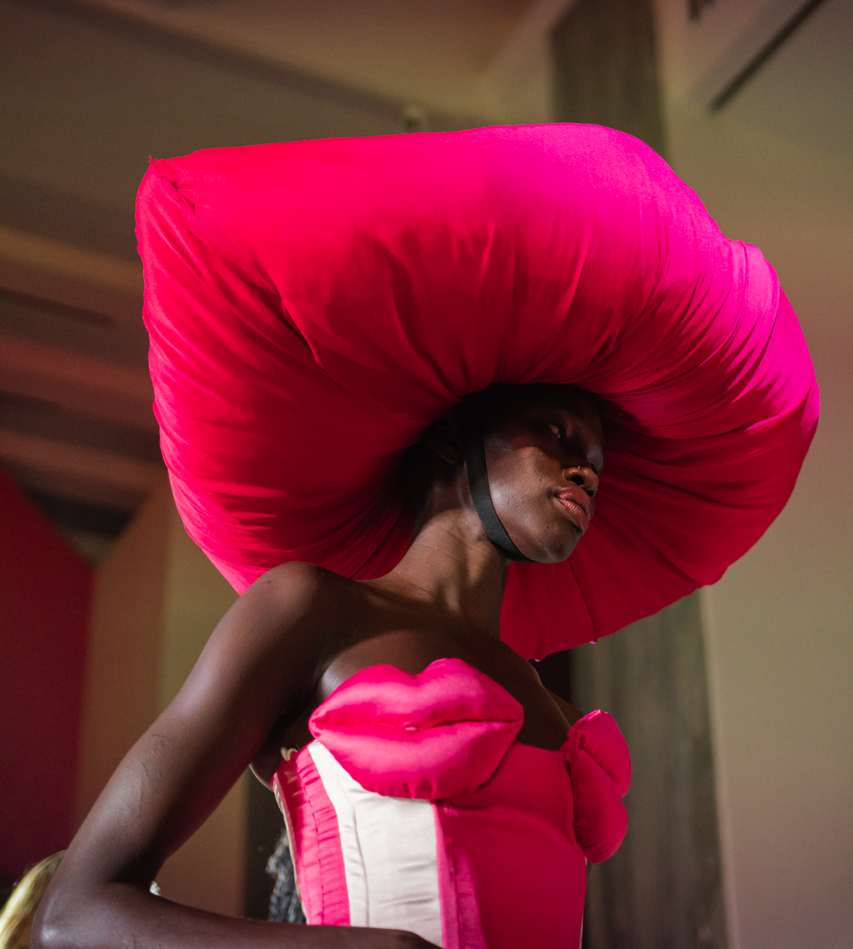
Bachelor of Arts in
FASHION DESIGN
Specialisations
Fashion Design
Fashion Styling and Communication
Campus
Milan – Rome
This BA aims at preparing students to enter the professional world within the national and international Fashion System. With a creative and practical approach, the programme guides students to find and develop their talents, led by a faculty consisting of professionals, and through collaborative experiences with companies and institutions connected to the cultural, social and economic life of Milan and Rome. It is a non-stop laboratory of ideas thanks to the collaboration among the different specialisations, which fosters the synergy of a real work team.

Slide 32
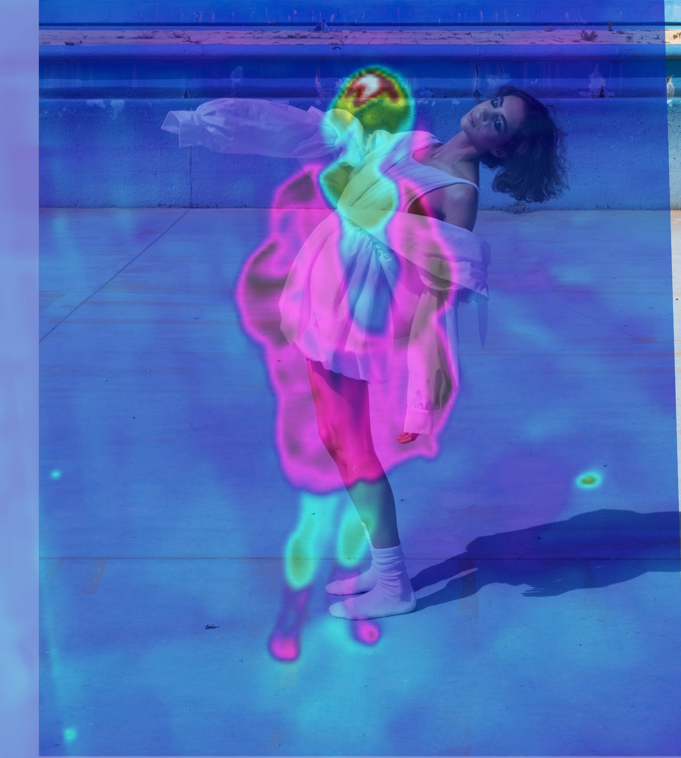
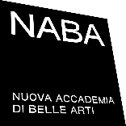
Bachelor of Arts in
FASHION MARKETING MANAGEMENT
Campus
Milan – Rome^{NEW!}
This course aims to train professional figures capable of managing the multidisciplinary complexities of the Fashion System, connecting the ideation and development phase of the product to marketing, communication, and distribution strategies. The course provides cultural, design, and management skills related to fashion supply chain and marketing management. Students will develop brand vision and identity projects, digital communication, and distribution starting from the knowledge of the product system and designing strategic processes related to the new demands of the digital marketing market and new models of creative entrepreneurship related to the supply chain and sustainable design.

Slide 33
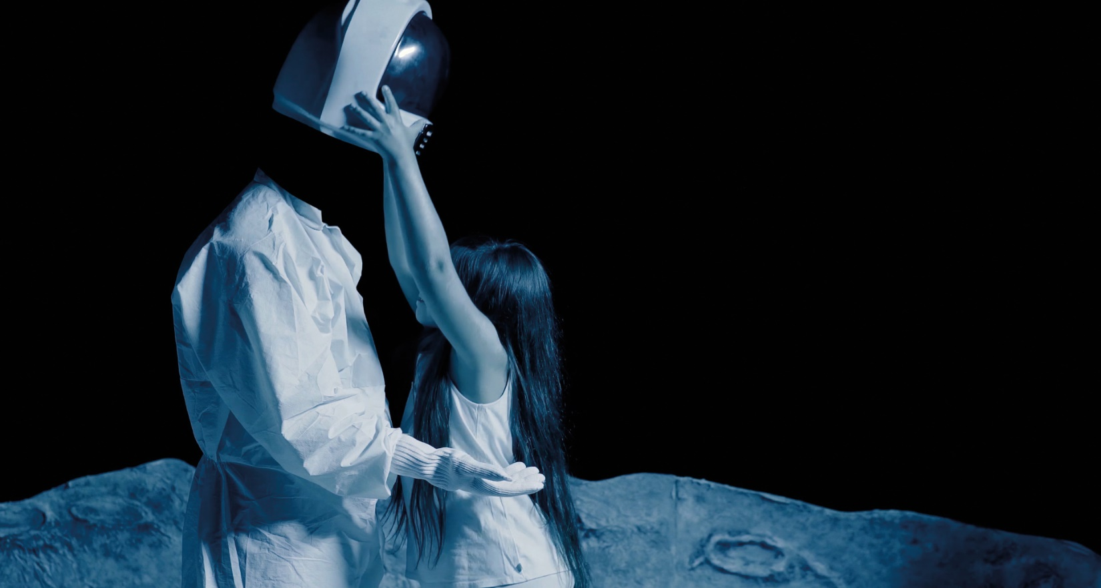
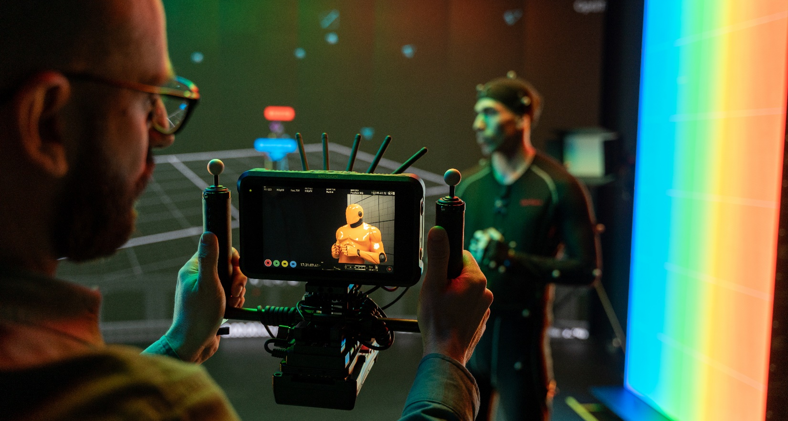
Bachelor of Arts in
CREATIVE TECHNOLOGIES
Specialisations
Game
VFX and 3D
Campus
Milan
The BA in Creative Technologies (First Level Academic Degree in New Technologies for Applied Arts) explores the world of CGI and aims at growing professional figures in the fields of Game, VFX and 3D. Over the whole programme the students learn the most innovative digital techniques: from virtual production to develop VFX in real time, to character design and animation with the use of motion capture systems, from the development of videogames to the design of virtual reality experiences.

Slide 34
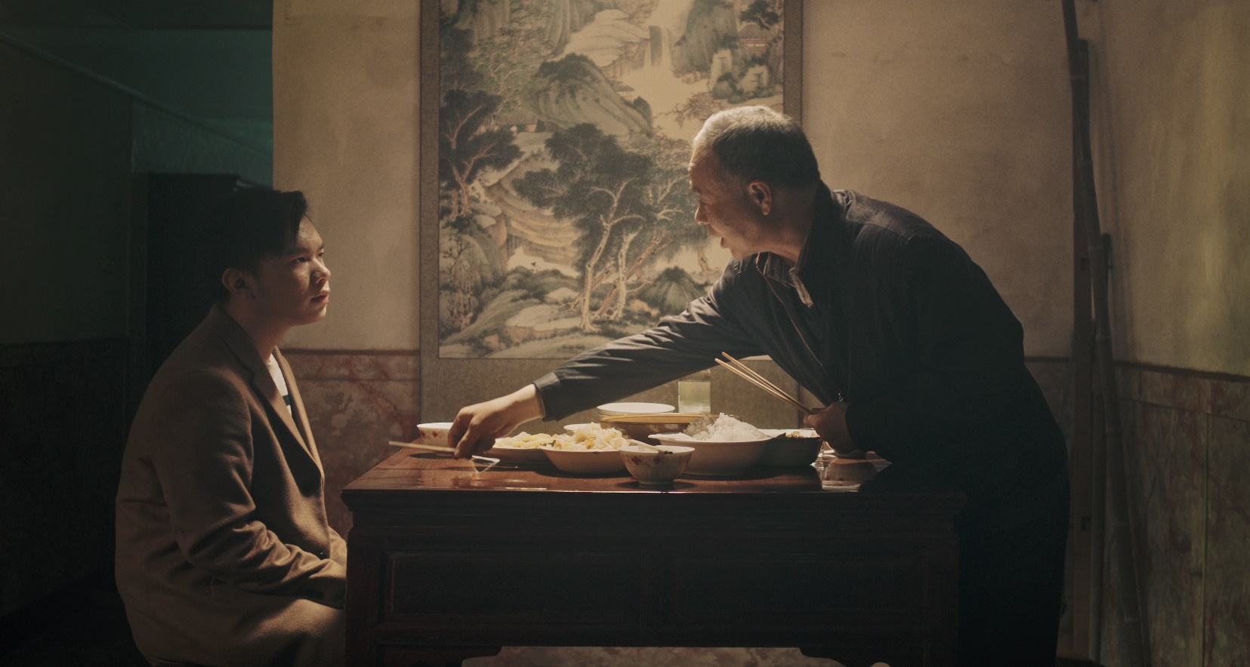

Bachelor of Arts in
FILM AND ANIMATION
Specialisations
Filmmaking
Animation
Campus
Milan – Rome
The BA in Film and Animation was born to prepare creative talents and professionals in the field of audiovisual creations, in particular in the branch of cinema, in both live action productions and animations, and in all the traditional, contemporary and future applications including their hybrid products. The dynamic nature of this industry and of new technologies assumes the outlining, even in the short term, of new professional roles, and the BA lays the foundations to keep up with these changes.

Slide 35
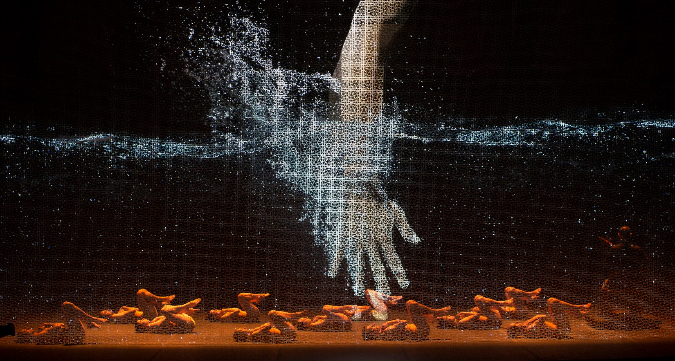
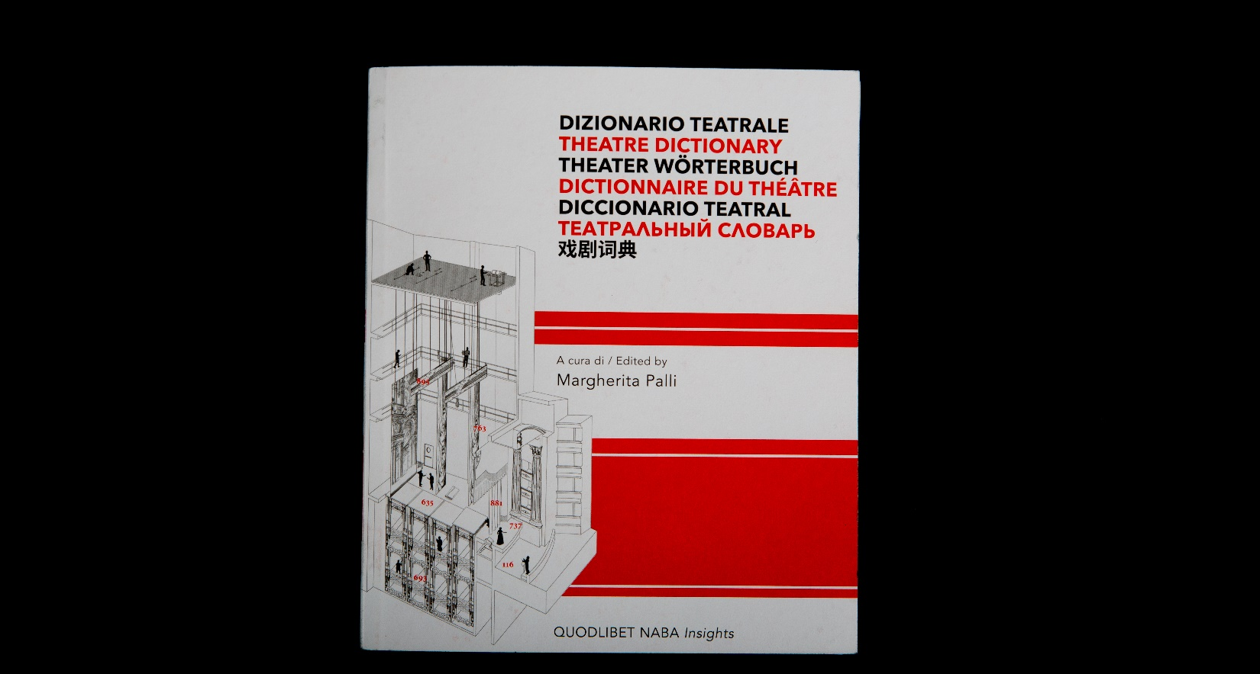
Bachelor of Arts in
SET DESIGN
Specialisations
Theatre and Opera
Media and Events
Campus
Milan
The BA provides students with the tools to address the complex reality of set design through the study of design-related topics in the fields of theatre, events, exhibitions, fashion shows, cinema and television, among others. Through crossover courses like photography, light design, costume design and performing arts, and internships at theatres and leading companies in the field, students acquire qualified skills to enter the professional world, including the development of professional dossiers, budgets and periodic analysis production, work planning and organisation.

Slide 36
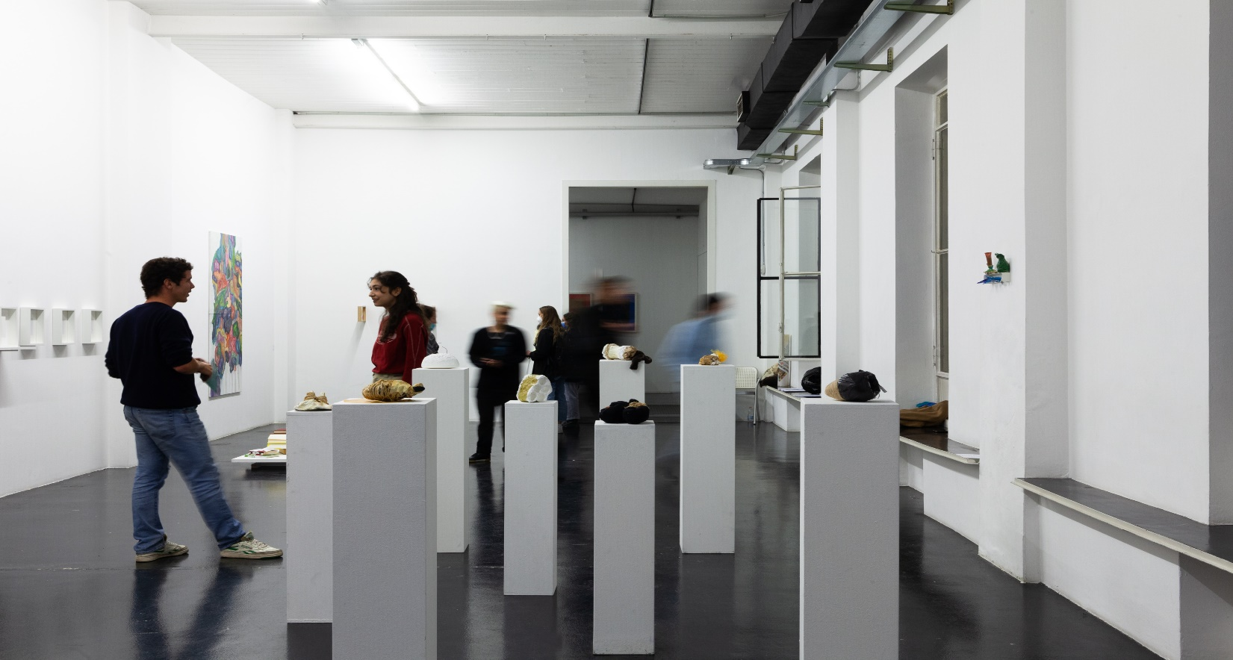
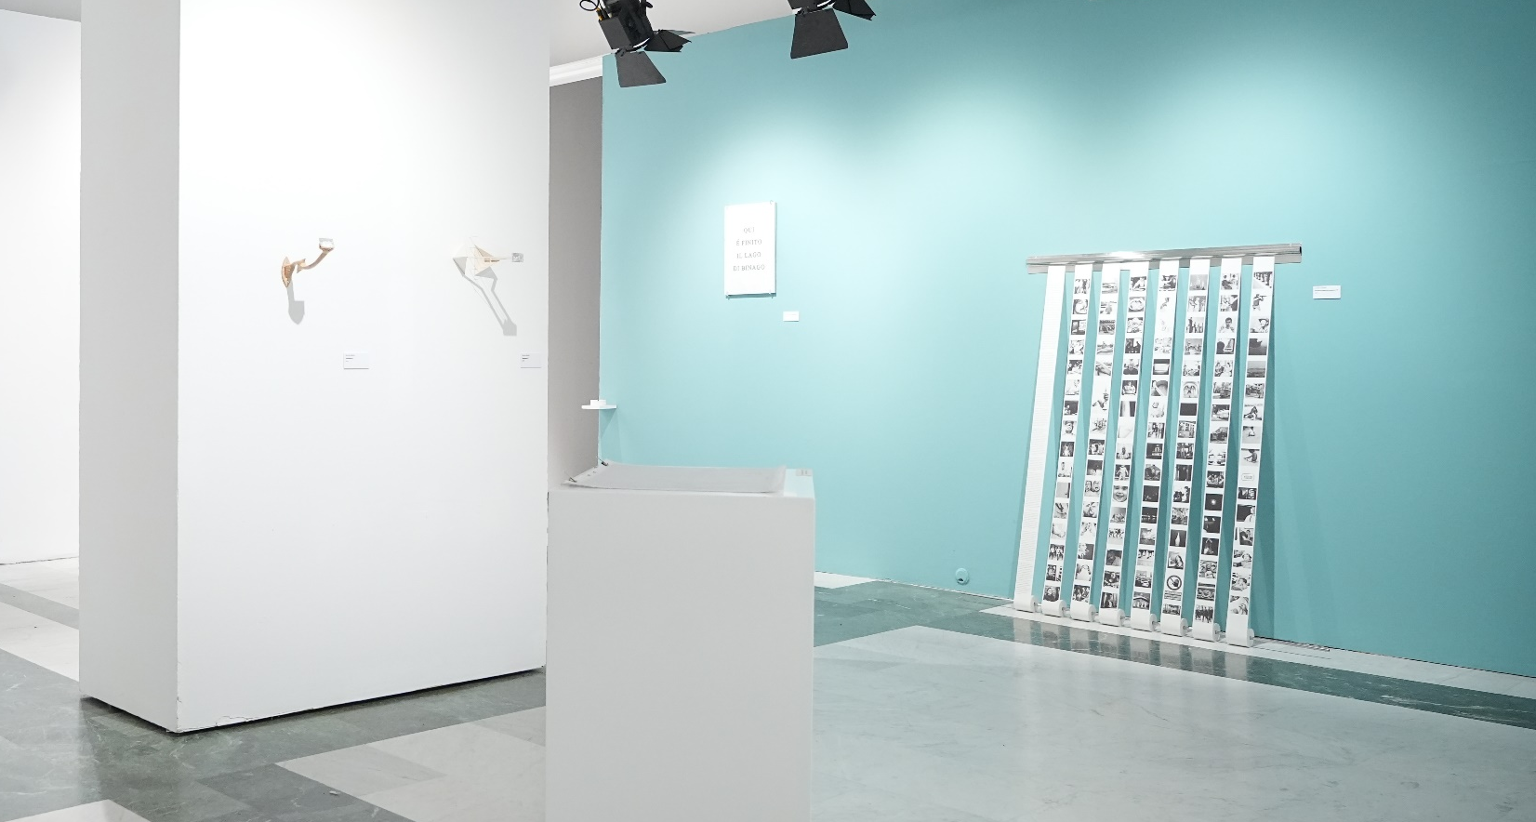
Bachelor of Arts in
PAINTING
AND VISUAL ARTS
Specialisations
Painting
Visual Arts
Campus
Milan – Rome
The BA explores the transformation of contemporary art practices, connecting art with different areas of the production and social contexts. Relating to the dynamics and values of the contemporary art system, the programme reinterprets and expands the traditional academic approach to painting and visual arts, guiding students through experimentation, investigating a variety of environments, techniques and methods, which will support them in developing an individual way of expressing themselves and their personal artistic ideas.

Slide 37
MASTERS OF ARTS

Slide 38
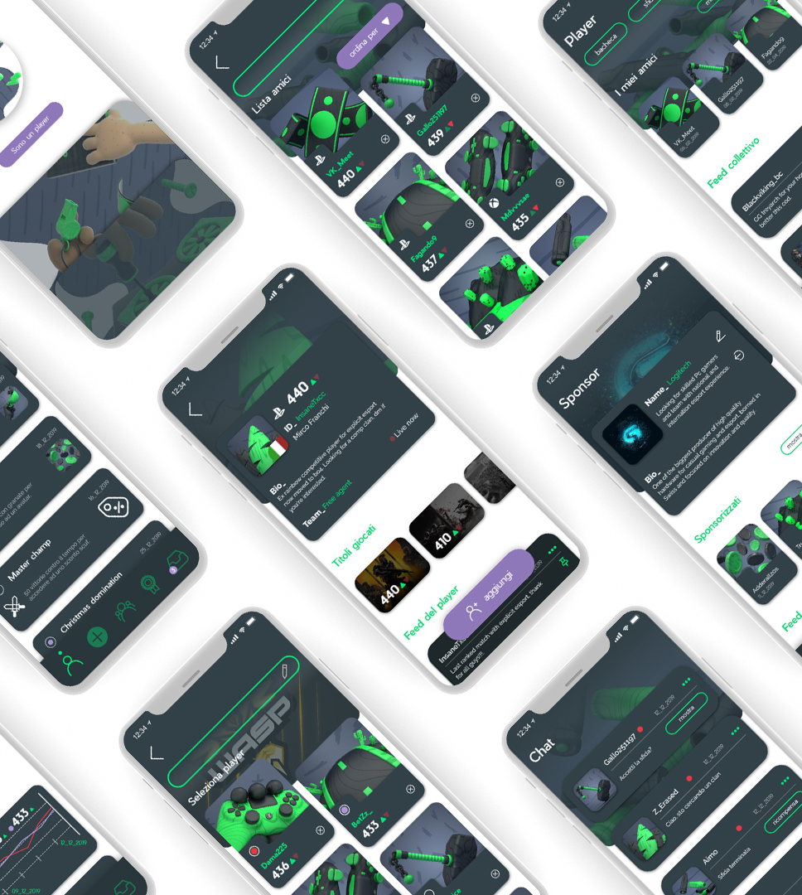
Master of Arts in
USER EXPERIENCE
DESIGN
Campus
Milan
The MA in User Experience Design (Second Level Academic Degree in Communication Design) provides the theoretical, technical and methodological skills for the design of complex digital communication systems. Through a continuous synthesis between creativity and strategy, and with an analytical and systemic approach to design that refers to cognitive psychology and contemporary visual culture, the MA deals with the study and design of digital interfaces and has a focus on user experience (UX/UI) as well as on information architecture.

Slide 39
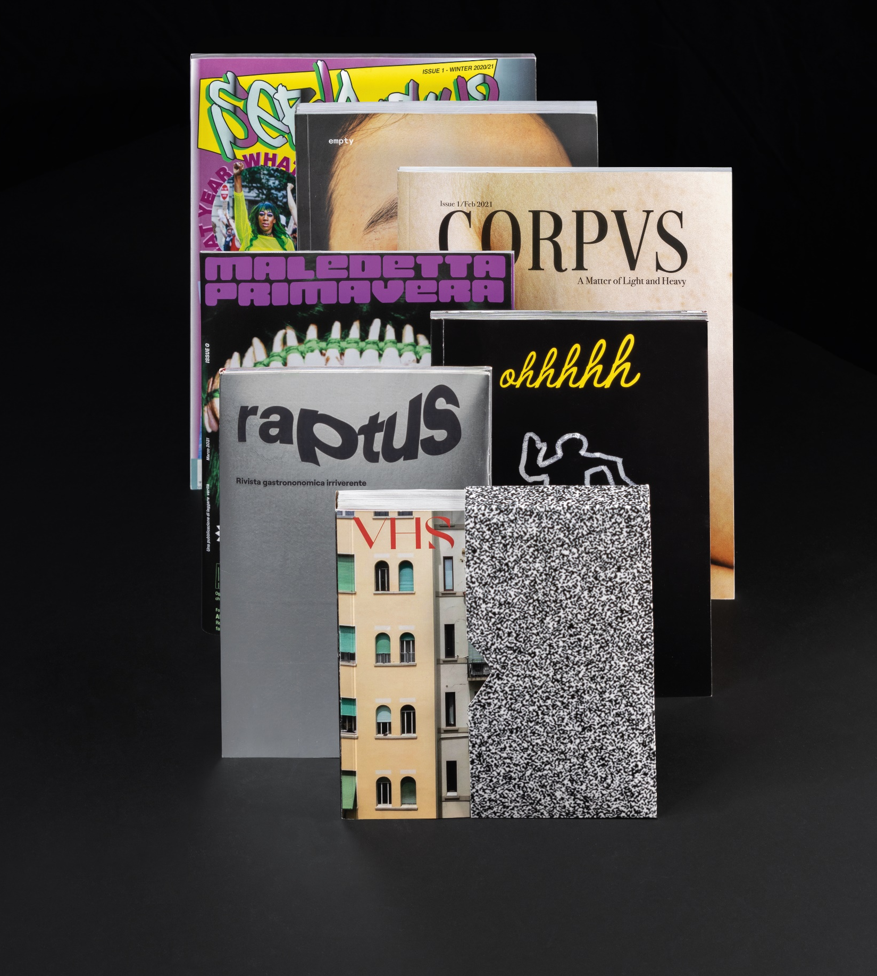
Master of Arts in
VISUAL DESIGN AND INTEGRATED MARKETING
COMMUNICATION
Campus
Milan – Rome
The MA in Visual Design and Integrated Marketing Communication (Second Level Academic Degree in Communication Design) provides a synthesis between the typical marketing approach, as usually covered in more corporate business oriented courses, to help students develop a solid background in the field, and the artistic-expressive approach as also used by new technologies, gaining a wide range of technical and design production skills. By working on real brief, they have the chance to put their acquired skills into practice and to undertake all phases of complex communication projects.

Slide 40
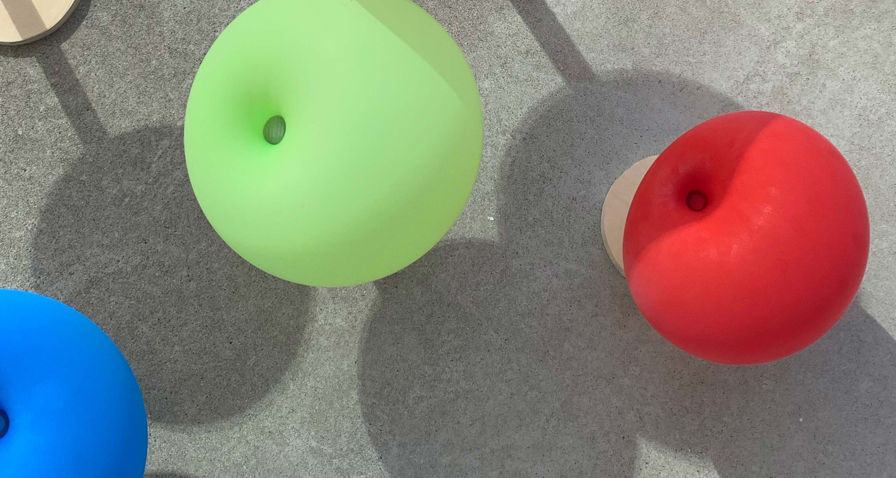
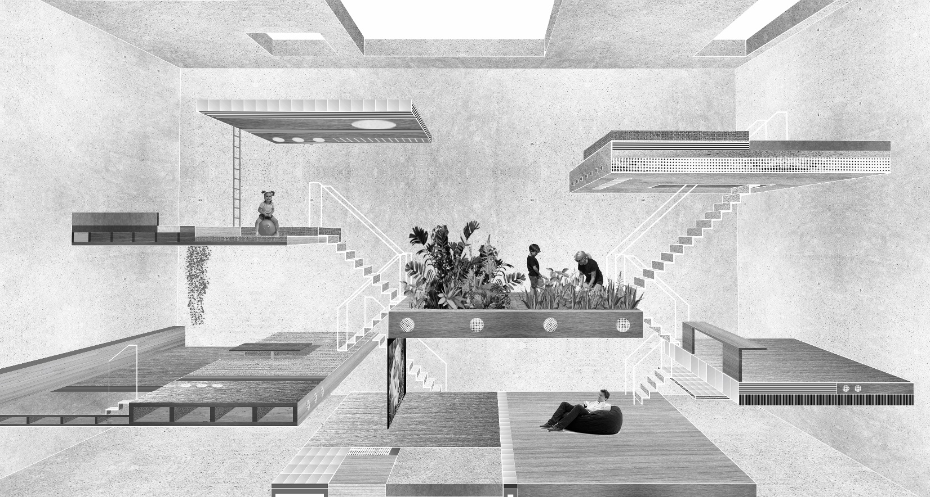
Master of Arts in
INTERIOR DESIGN
Campus
Milan
The MA in Interior Design (Second Level Academic Degree in Design) develops all-round professional profiles ready to enter the global marketplace. In the contemporary world, interiors play an increasingly important role in individual and collective living spaces of global cities, becoming part of a complex physical and narrative system. The MA enables its students to deal with conceptual and operational issues through an interdisciplinary approach open to innovation and cultural exchange, and different project experiences led by international professionals.

Slide 41
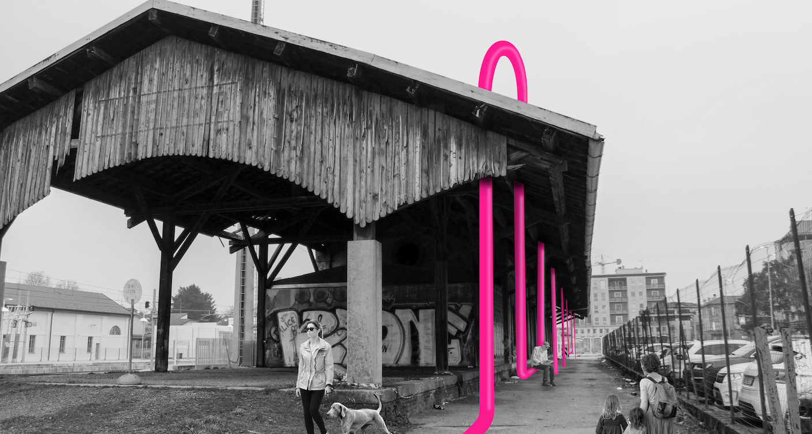
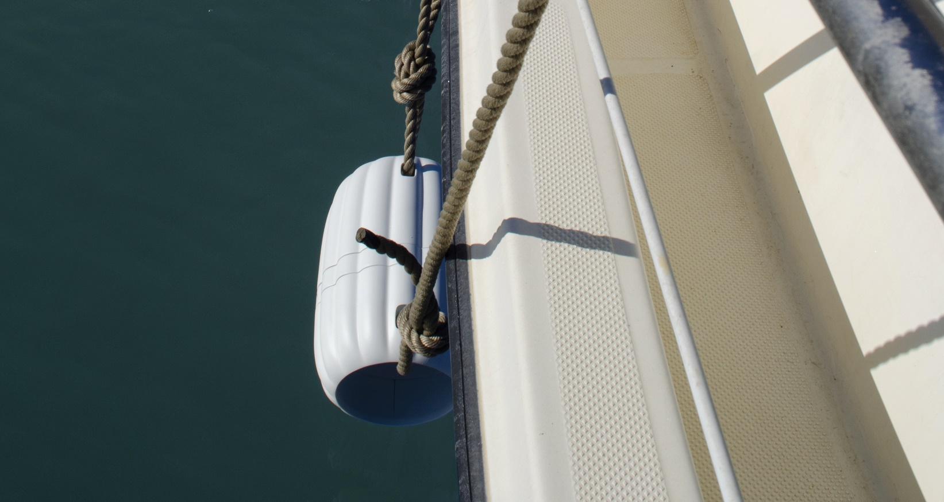
Master of Arts in
PRODUCT
AND SERVICE DESIGN
Campus
Milan
The transition of the modern world from a “society of goods” to a “society of services”, and the search for a sustainable relationship with nature, gives designers the chance to explore the ethics of design more thoroughly. During the MA in Product and Service Design (Second Level Academic Degree in Design), professors and professionals guide students to become full-scale designers, capable of envisioning new products and services, managing all phases of a project’s development, from conception to manufacturing and release onto the market, through definition of the design strategy and material researching.

Slide 42
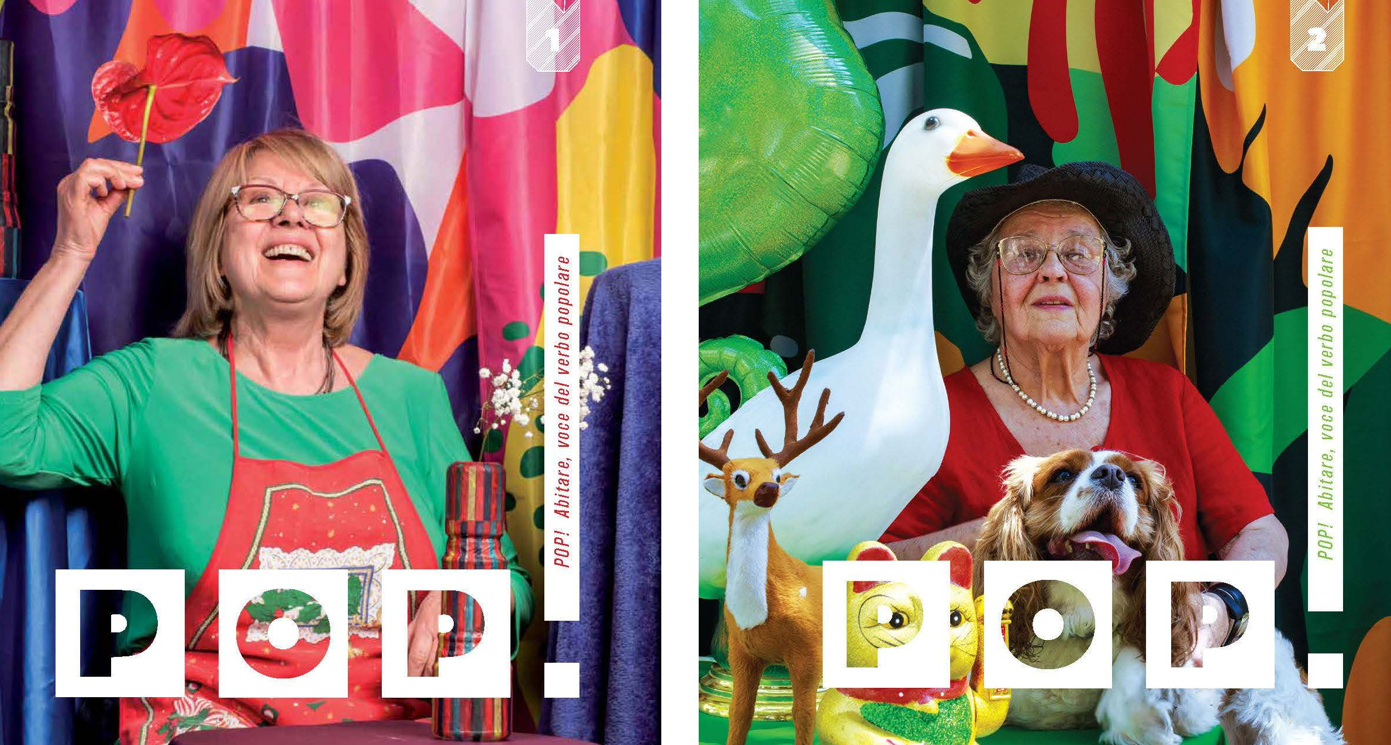
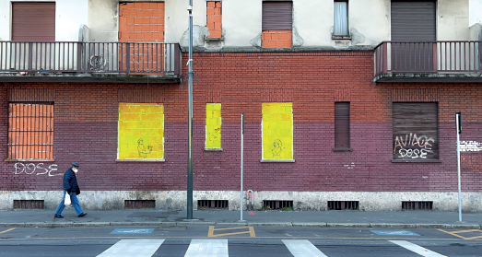
Master of Arts in
SOCIAL DESIGN
Campus
Milan
If focused on social development strategies, design is capable of valorising human and natural resources, driving sustainable innovation, and promoting the empowerment of local communities and social evolution through the activation of micro and macro economies: social design is acquiring an increasingly significant role in the projects of companies and public administrations. The MA in Social Design (Second Level Academic Degree in Design) enables students to understand and to explore new scenarios for practicing design in today’s and tomorrow’s world.

Slide 43
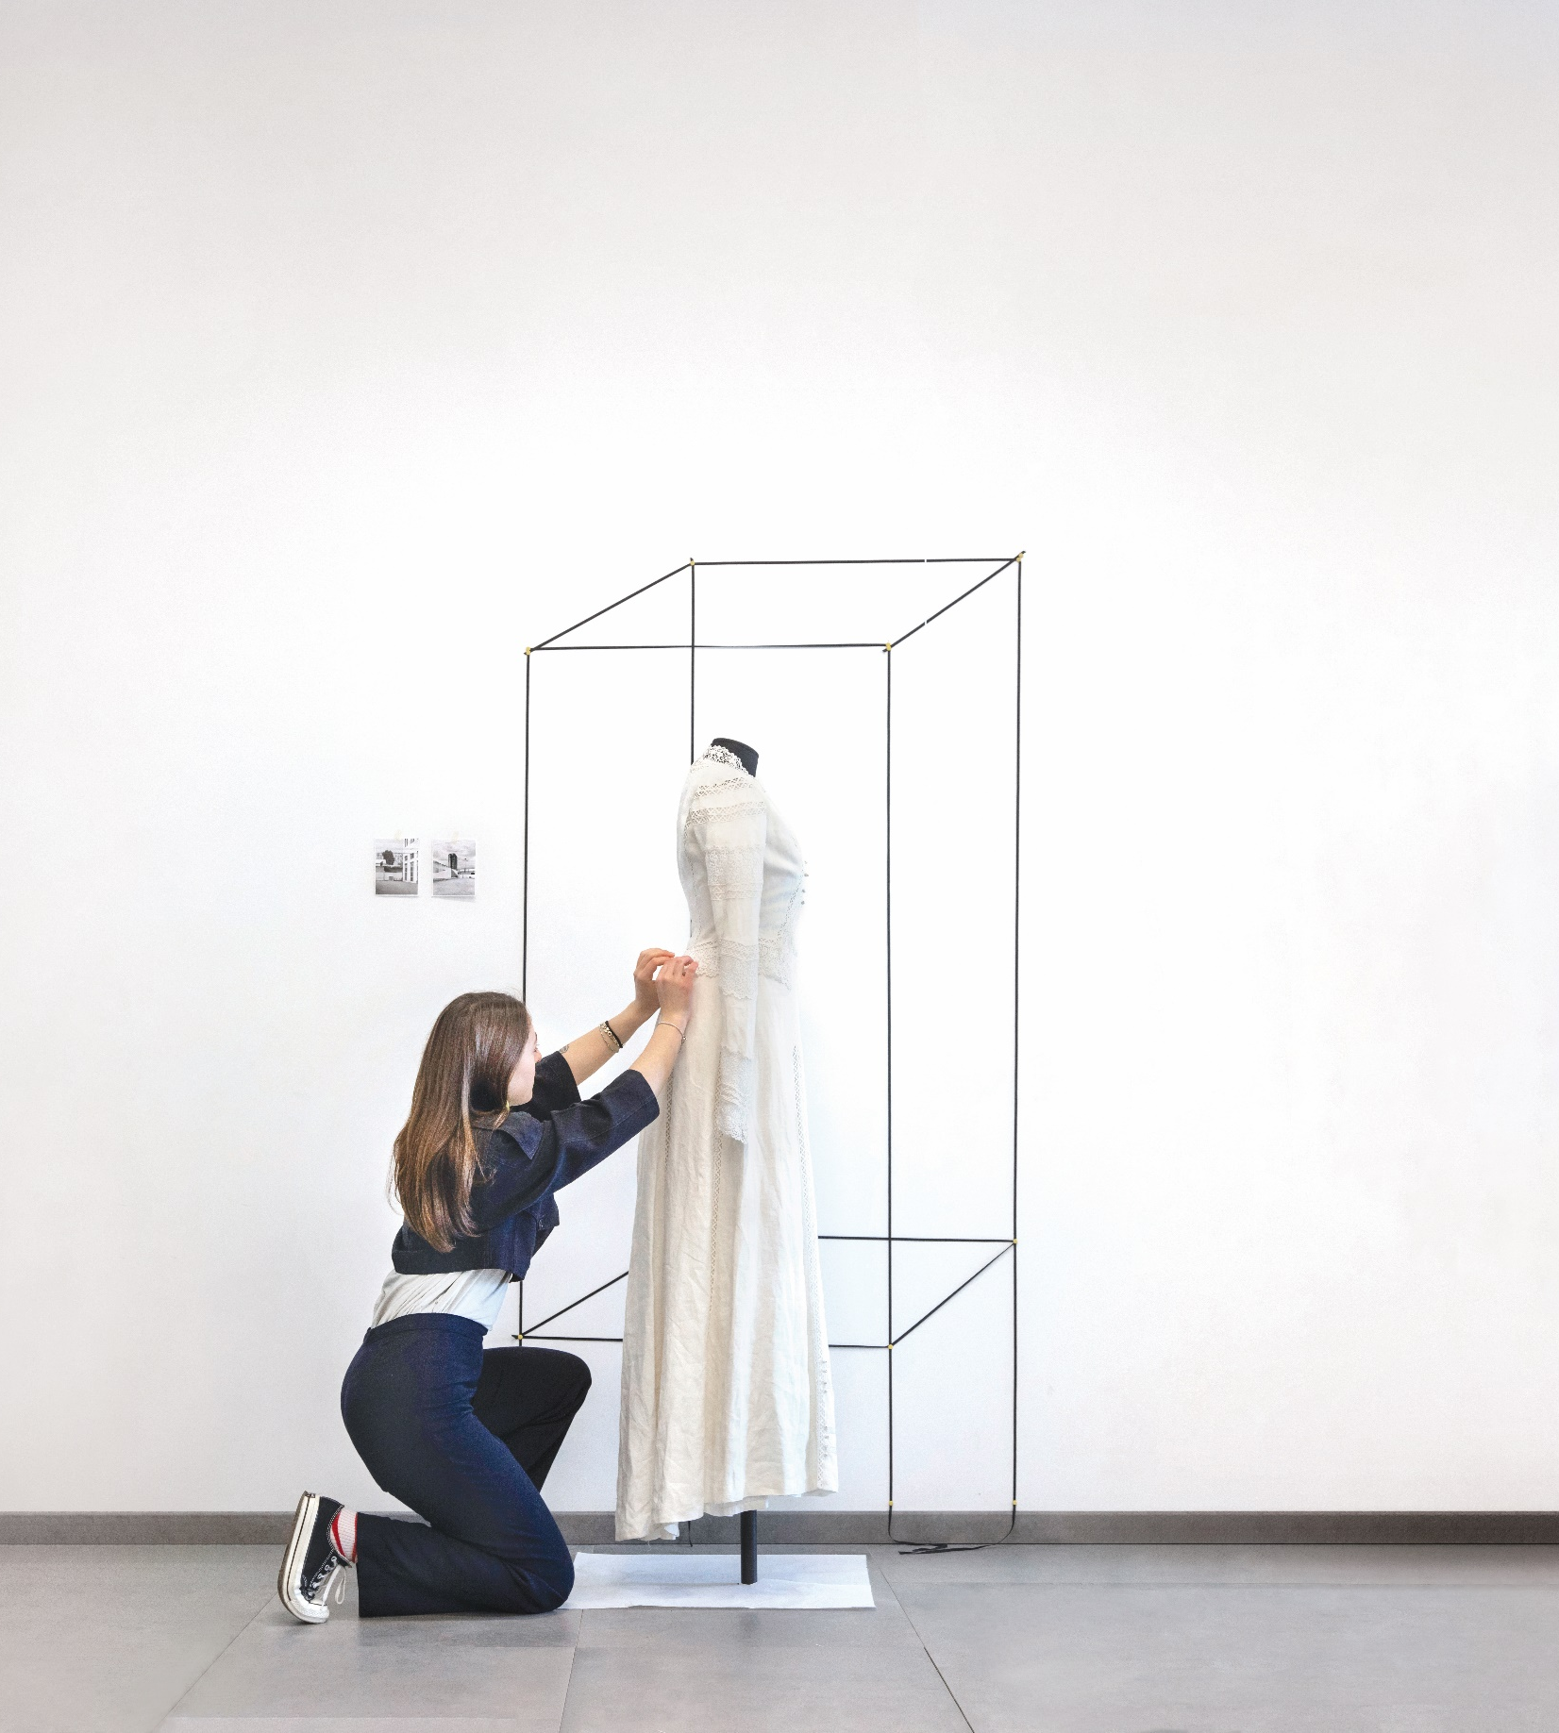
Master of Arts in
FASHION AND
COSTUME DESIGN
Campus
Rome
The Master of Arts in Fashion and Costume Design (Second Level Academic Degree in Fashion and Textile Design) gives the students the necessary skills to handle experimental design, laboratory, and cultural projects that are linked to fashion and costume design. The course aims at investigating, over the two years, the topic of narration and mise-en-scène of garments created for specific events and bodies, covering the topic of archives and collections as heritage and starting points for designing.

Slide 44
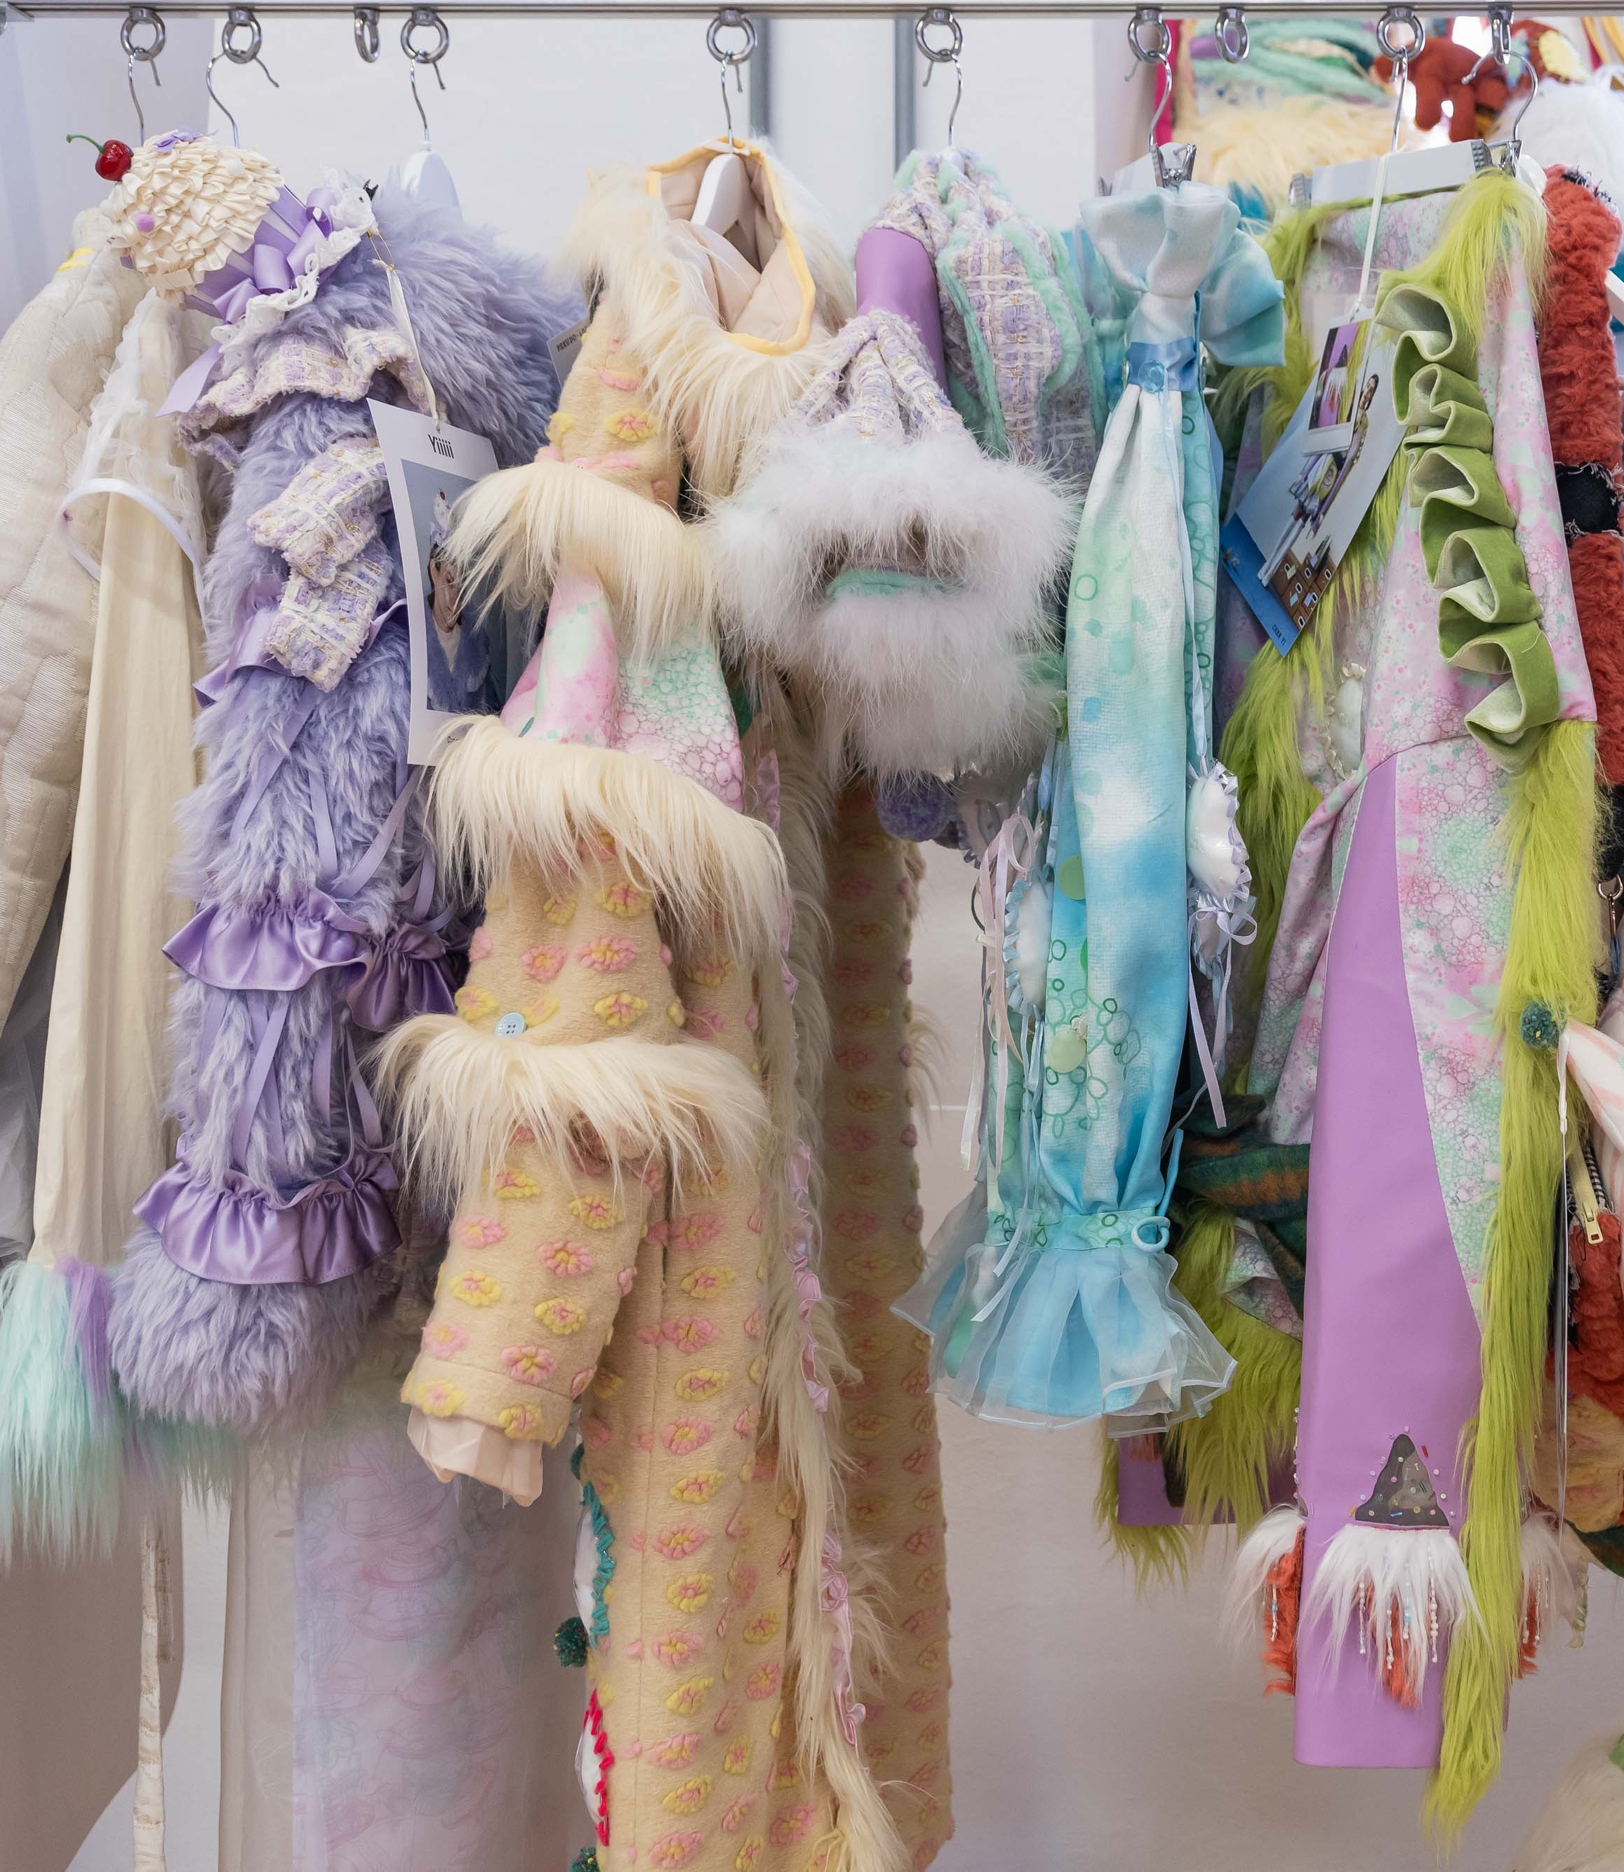
Master of Arts in
FASHION DESIGN
Campus
Milan
The MA in Fashion Design (Second Level Academic Degree in Fashion and Textile Design) trains professional figures to manage creative processes in the field of fashion design, from research to prototyping. Its innovative and sustainable workshops as well as the cultural contents allow the students to understand those elements of the fashion language that relate to the creation of apparel collections. Our lecturers, all industry professionals, guide the students in the search for their own vision that will be expressed in a very personal portfolio.

Slide 45
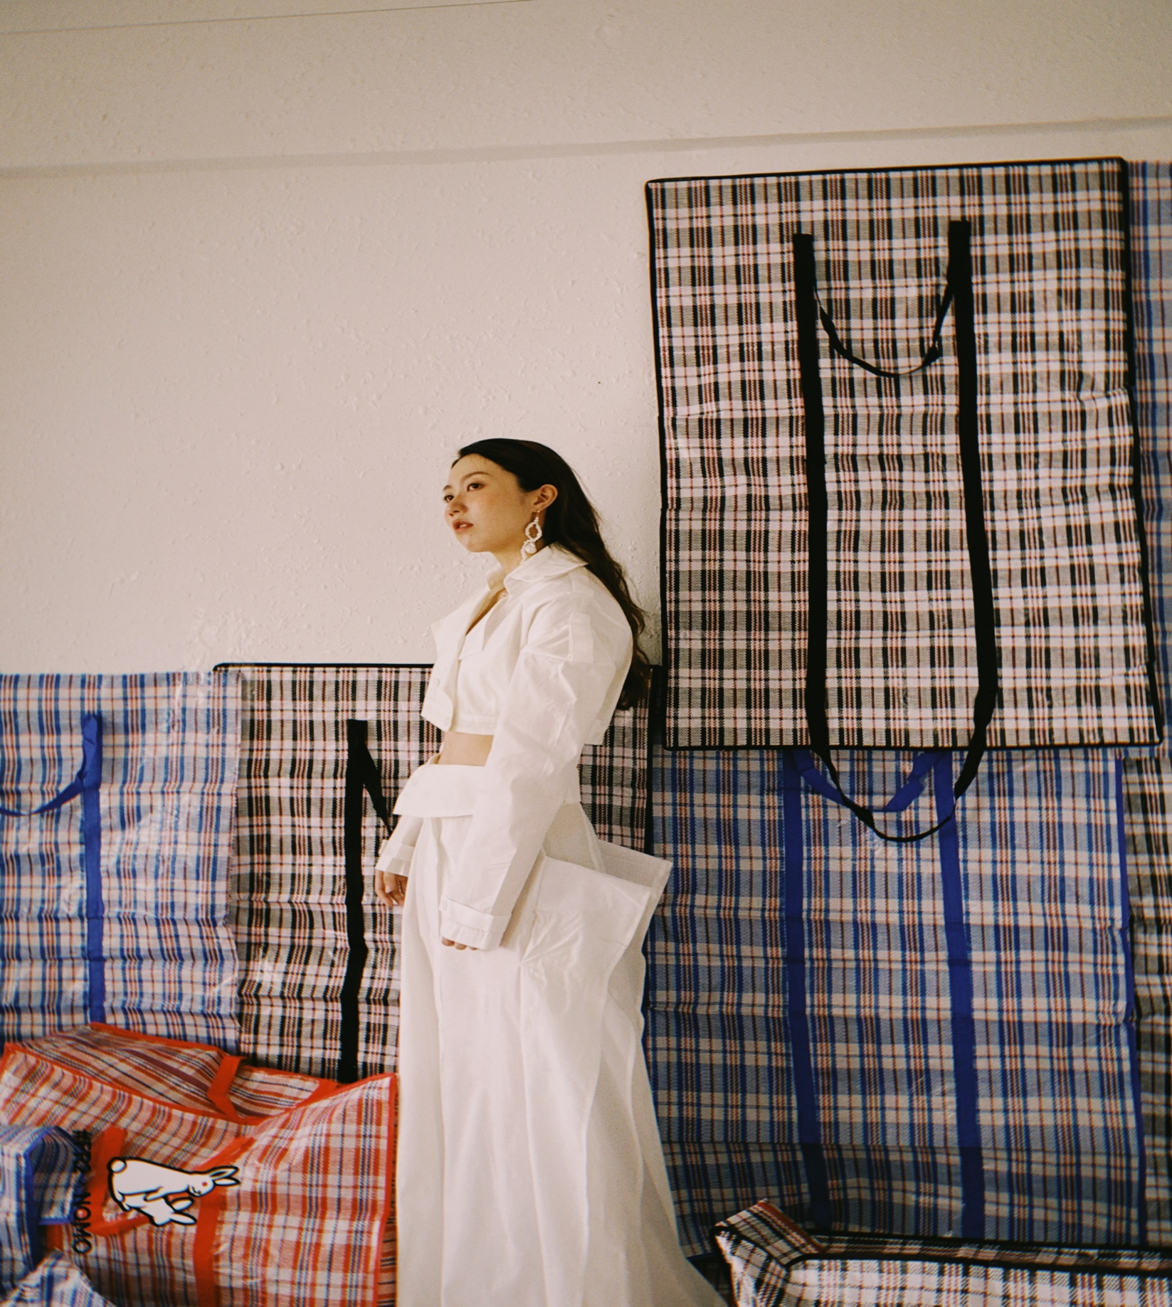
Master of Arts in
TEXTILE DESIGN
Campus
Milan
The MA in Textile Design (Second Level Academic Degree in Fashion and Textile Design) trains professional figures to manage creative processes in the fields of textile and knitwear design. Thanks to the collaboration with companies of the Italian system, the course offers innovative and sustainable workshops as well as cultural contents that provide thorough knowledge of the subject, and of its expressions in the fashion and art fields. Our lecturers, all industry professionals, guide the students in the search for their own vision that will be expressed in a very personal portfolio.

Slide 46

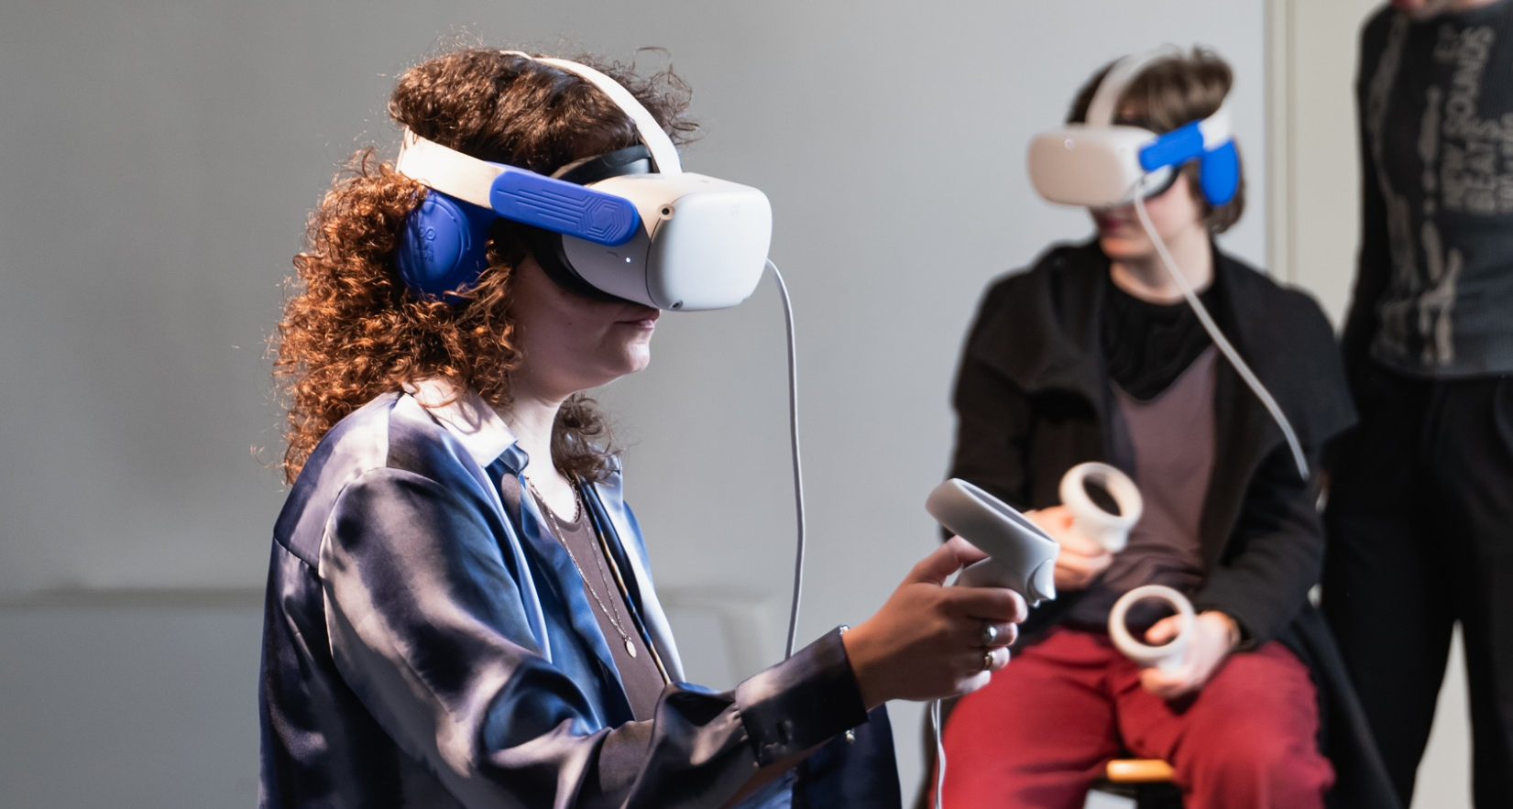
Master of Arts in
CREATIVE MEDIA PRODUCTION
Campus
Milan
The MA in Creative Media Production (Second Level Academic Degree in New Technologies for Arts) investigates the complexity of the physical and digital world, inquired and narrated through video cameras, microphones, databases, and sensors. It explores the creative possibilities offered by traditional and experimental audiovisual media and by new technologies. It’s grounded on solid theories and methods to develop an innovative artistic expressive representation of reality through linear and non-linear audiovisual productions, enhanced by the adoption of creative coding, human-computer interaction, x-reality, Artificial Intelligence and generative sound design.

Slide 47
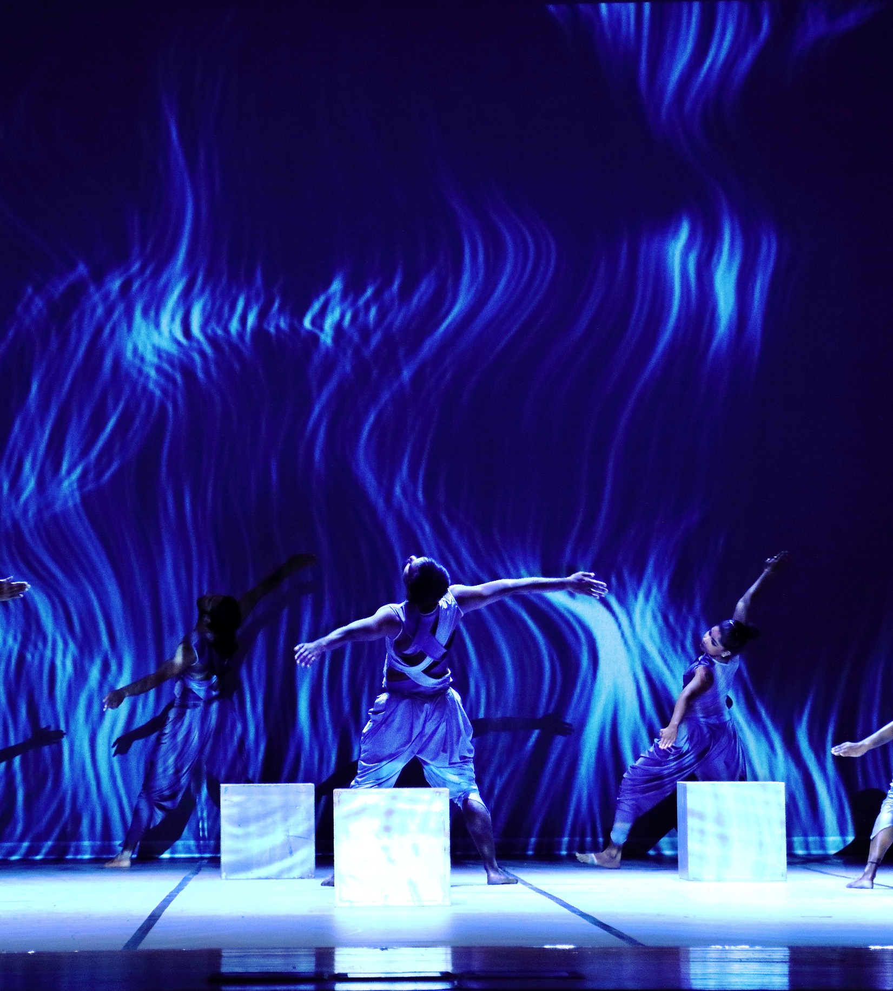
Master of Arts in
DIGITAL AND LIVE PERFORMANCE
Campus
Milan
The MA in Digital and Live Performance (Second Level Academic Degree in New Technologies for Art) is a highly specialised interdisciplinary course focusing on different areas, including contemporary dramaturgy, body and movement, new technologies, interaction and sound design. The two-year MA is unique in Italy and aims to establish a set of methods to research innovative languages, ideate and design multidisciplinary artistic performances, training professionals able to dialogue and interact with international productions.

Slide 48
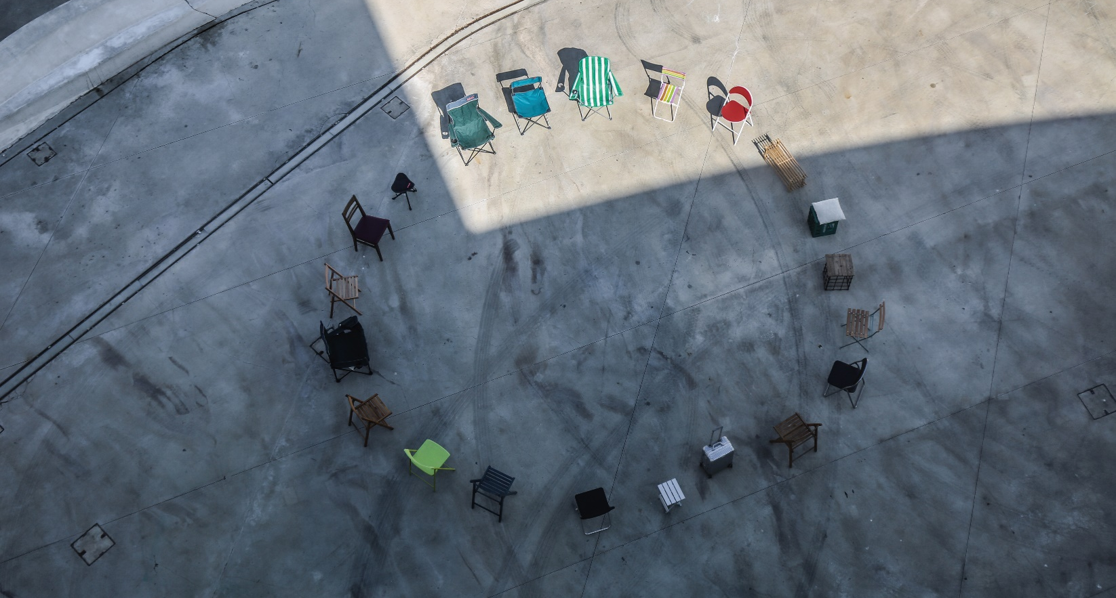
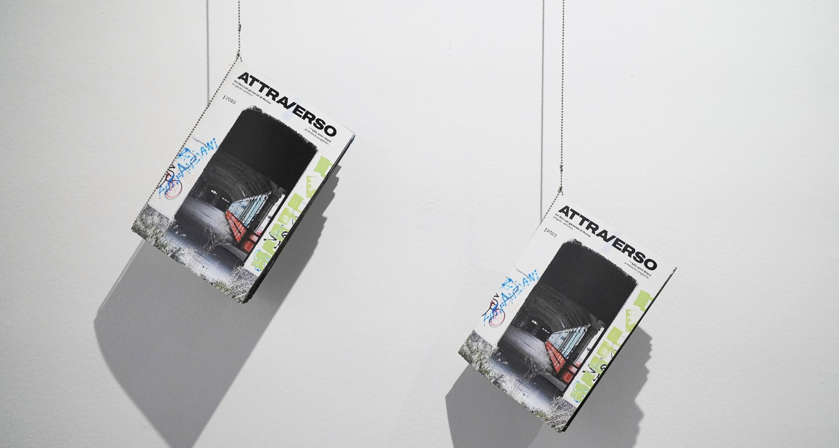
Master of Arts in
VISUAL ARTS AND CURATORIAL STUDIES
Campus
Milan – Rome
Established in 2006, the MA combines solid training in artistic production with highly specialised curatorial practice. Lead by globally recognised artists, curators, critics and intellectuals, the programme explores the relationship between art, visual culture, aesthetics and social dynamics, focusing on the main research and theoretical methodologies of contemporary art. Given the solid positioning of the NABA Visual Arts Department within the contemporary art system, students will tackle interdisciplinary activities, and new training and operating models in contemporary art.

Slide 49
ACADEMIC MASTERS

Slide 50

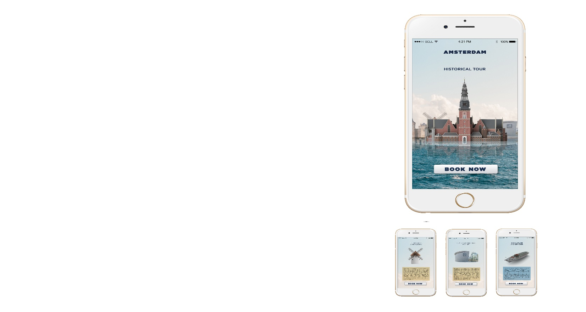

Academic Master in
CREATIVE ADVERTISING
Campus
Milan
The Academic Master provides students the chance to develop their talents in copywriting, storytelling and art direction, enabling them to ideate campaigns across various types of media. The programme alternates the teaching of the basics of creative advertising - from terminology to project logics - to a “learning by doing” didactic approach: students, in fact, will attend intensive workshops with leading companies and sector professionals and will be encouraged to participate in prestigious international creative competitions.
Available also with the HYBRID PART TIME formula
For this Master, in addition to the standard delivery, NABA also offers the opportunity of remote midweek evening lessons and one weekend per month in-presence to flexibly combine study and work.

Slide 51

Academic Master in
LUXURY BRAND MANAGEMENT^{NEW!}
Campus
Milan
The Academic Master is an immersive didactic experience, equipping students with the tools to design innovative strategies that enhance the identity of luxury brands, exploring the dynamics of the target market, both in services and highend products, focusing on sustainability, digital innovation, and evolving consumption experiences. Combining theoretical lectures on branding and strategic management with workshops with leading industry companies, students will develop communication strategies based on new aesthetic and artistic languages, and the emotional aspects of the consumer experience, serving as the foundation of cross-media campaigns and international retail strategies.
FAST TRACK option
NABA offers the possibility to transition from the Academic Master to the Master of Arts in Visual Design and Integrated Marketing Communication upon completion of the Academic Master and achieving a minimum number of credits.

Slide 52

Academic Master in
SUSTAINABLE INNOVATION COMMUNICATION
Campus
Milan
The Academic Master explores theories, methods and design approaches to contemporary communication through an intensive programme and helps students to develop cross-disciplinary analysis, cultural coding and language skills pertinent to the sustainable innovation of institutions, public and private companies. It provides students with the competences to design and plan communication systems in which marketing, strategy and creativity are integrated with coherence and harmony in order to enhance the eco-systemic impact of cultural and technological innovation with focus on sustainability.

Slide 53

Academic Master in
INTERIOR AND
LIVING DESIGN^{NEW!}
Campus
Milan
The Academic Master explores the world of interior and living design, equipping students with the skills needed to design spaces that meet the demands of an ever-evolving world. Students will learn design principles aimed at creating environments that combine functionality, aesthetics, and innovation, through theoretical learning focusing on sustainability, innovative materials, and digital design technologies, and an educational approach based on learning by doing, thanks to practical workshops and collaborations with leading industry companies.
FAST TRACK option
NABA offers the possibility to transition from the Academic Master in Interior and Living Design to the Master of Arts in Interior Design upon completion of the Academic Master and achieving a minimum number of credits.

Slide 54

Academic Master in
ITALIAN DESIGN
Campus
Milan
The Academic Master is an experiential journey to research and analysis of the features of the Italian Design. An intensive programme which combines theory, knowledge and method, workshops and meetings with the main players in this field to explore the most advanced edges of the Italian approach to projects. The course trains professionals able to pick up on and lead trends at an international level, contributing to both innovation in industrial production, and development of new aesthetic visions and cultural values.

Slide 55

Academic Master in
NEW URBAN DESIGN
Campus
Milan
The Academic Master gives a new perspective on the role of urban designers, and allows the students to enhance their experience in reading into, interpreting and designing cities to face the new complexity of urban contexts, and complement it with practical actions also establishing relationships with local and international partners. Through the research of new ways to understand the city, this course develops the specific necessary skills to carry out new urban design projects, with specific attention to service design.

Slide 56

Academic Master in
FASHION DIGITAL MARKETING
Campus
Milan
The Academic Master is an intensive study path that analyses the developments of the contemporary fashion system in terms of marketing, communication and culture, with the aim of preparing professionals in the digital marketing field, capable of creating specific contents and strategies for fashion and lifestyle brands. With the study of digital technologies, tools and media within theoretical and project-based courses, where lectures are complemented by seminars and thematic workshops, the students can develop a self-sufficient, innovative and critical approach.
Available also with the HYBRID PART TIME formula
For this Master, in addition to the standard delivery, NABA also offers the opportunity of remote midweek evening lessons and one weekend per month in-presence to flexibly combine study and work.

Slide 57

Academic Master in
SNEAKER DESIGN^{NEW!}
Campus
Milan
The Academic Master (First Level Academic Master Degree in Footwear Design) trains professionals in the field of shoe design, in particular streetwear, with an approach which pairs sound theoretical foundations, laboratory experience and collaborations with companies within the targeted industry. The students will acquire specific skills in designing and prototyping artisanal and industrial products, with special attention to innovation, market trends and sustainable production.

Slide 58

Academic Master in
SCREENWRITING
FOR SERIES
Campus
Rome
This Master is an intensive programme that integrates theories, methods and hands on projects by developing cross-disciplinary skills of analysis and cultural coding of contemporary languages. It intends to train professionals figures in the field of audio-visual screenwriting who will be capable of intercepting compelling themes and narratives for the constantly evolving world of the development of serial projects of national and international relevance.

Slide 59

Academic Master in
ART AND ECOLOGY
Campus
Milan
The Academic Master provides the students with a cross-disciplinary methodological approach and the needed tools to fulfil the most urgent issues related to landscape, environmental protection, biodiversity and sustainability, by connecting artistic creativity, design practice and scientific knowledge. Through theoretical seminars, experimental workshops and field research, the students explore the dynamics and stratifications that define an ecosystem (natural and social).

Slide 60

Academic Master in
CONTEMPORARY
ART MARKETS
Campus
Milan
The Academic Master is an intensive study path directed at providing students with effective tools for the interpretation of art market dynamics, with particular focus on contemporary artistic languages. The first cycle of the programme is dedicated to classroom activities, workshops and visits to galleries, foundations, museums, private and corporate collections. The second is focused on internships, enabling students to experience different areas and professions of the art system first-hand, and on the final projects. Students will also attend study trips to key events in the field such as Artissima and Art Basel.
Available also with the HYBRID PART TIME formula
For this Master, in addition to the standard delivery, NABA also offers the opportunity of remote midweek evening lessons and one weekend per month in-presence to flexibly combine study and work.

Slide 61

Academic Master in
PHOTOGRAPHY
AND VISUAL DESIGN
Campus
Milan
The Academic Master prepares professionals for their entry into the world of photography, arts, and national and international communication, integrating theoretical study with projects, workshops and guided visits to research centers and exhibition spaces, audiovisual production facilities, publishing houses, theatres, artists’ studios, museums and contemporary art galleries. The second part of the programme is dedicated to a period of internship in collaboration with a network of partner companies and institutions that facilitate the entry of students into the job market.

Slide 62
RESEARCH DEGREES

Slide 63

PhD in
ARTISTIC PRACTICE
Campus
Milan
NABA is the first Academy of Fine Arts in Italy to establish a completely practicebased Doctoral School. The PhD is
developed in collaboration with HDK-Valand - Academy of Art and Design (awarding university), has a duration of 4 years and is aimed at students who intend to transform their artistic practice into a professional career.

Slide 64

PhD in
ARTISTIC PRACTICES
AND DESIGN CULTURE^{NEW!}
Campus
Milan
NABA stands out as a reference point among the Italian Academies since the 1st AFAM doctoral cycle for artistic research and design culture. The 3-year PhD trains artists,
designers, and curators to develop research and production through innovative critical, empirical, and intersectional methods and tools.

Slide 65
OTHER PROGRAMMES

Slide 66

SEMESTER ABROAD PROGRAMMES
The Semester Abroad Programmes are designed for international students who wish to spend a semester studying at NABA in Milan or Rome.
SUMMER COURSES
NABA promotes two-week summer intensive courses in the Visual and Applied Arts fields at one of its campus or both, providing students with campus experience and field trips.

Slide 67

CORSI BREVI
(Short Courses)
Provided exclusively in Italian language, they are designed for an audience of students and professionals, but also for anyone without an academic qualification, to improve their own skills in their field of interest.
FOUNDATION
COURSE
A propaedeutic and interdisciplinary programme aimed at students who do not meet the entry requirements for undergraduate programmes. The course provides linguistic, cultural, and artistic competences.
GAP YEAR PROGRAMME
The programme provides students having a secondary school diploma with the opportunity to live a unique experience in Italy by taking part to the first year of a NABA BA in Milan or Rome.

Slide 68

ERASMUS+
AND INTERNATIONAL EXCHANGE
NABA develops and promotes opportunities for students to study abroad as part of their academic experience. Erasmus+ and International Exchange programmes allow students to join the regular classes and study paths alongside NABA degree students.
DIPLOMA PROGRAMMES
Diploma Programmes have the same curricula and the same examinations as the BA Programmes, however they lead to the awarding of a NABA diploma and not degree.

Slide 69
INDUSTRY RELATIONS AND
CAREER SERVICE AND ALUMNI RELATIONS

Slide 70

INDUSTRY RELATIONS
The Industry Relations office represents a bridge connecting the Academy with the working world organising collaborations with companies:
Workshop: starting from the actual needs of the company involved, NABA offers different types of partnership.
Residency: students and lecturers leave the classroom and focus on the brief in an extra-academy context over a period of four days.
Design Marathon: a 48-hour competitive workshop that involves the best NABA students in a design challenge based on one or more project briefs proposed by global Brands and Companies.
CAREER SERVICE
The Career Service and Alumni Relations office supports students and alumni in the construction of their career path through:
Support in preparing CV, portfolio and internships activation.
NABASympliciy: on-line platform where students and alumni can showcase their CV and portfolio and where companies can advertise internships and job offers.
Talent Harbour: event that offer a unique occasion for students and companies to meet and know each other’s.

Slide 71

STAGE, PLACEMENT AND PROJECTS WITH
OVER 900 BRANDS EVERY YEAR, AMONG OTHERS:

Slide 72
SUCCESS STORIES

Slide 73



SUCCESS STORIES
COMMUNICATION AND GRAPHIC DESIGN AREA
FRANCESCO ALBANO
SOCIAL MEDIA SPECIALIST, WARNER BROS DISCOVERY
MA in Communication Design graduate
DESIGN AREA
YUDAN PENG
EMEA EXPORT SALES SPECIALIST, FENDI CASA
BA in Design graduate
FASHION DESIGN AREA
LORENZO SEGHEZZI
FOUNDER AND FASHION DESIGNER, LORENZO SEGHEZZI
BA in Fashion Design graduate

Slide 74



SUCCESS STORIES
MEDIA DESIGN AND NEW TECHNOLOGIES AREA
ARON GILLI
GAME DEVELOPER, STUDIO EVIL
BA in Creative Technologies graduate
SET DESIGN AREA
GRETA COSENZA
SET DESIGNER ASSISTANT, MASTERCHEF ITALIA
BA in Set Design graduate
VISUAL ARTS AREA
RUTH BERAHA
ARTIST, PREMIO NEW YORK, POLLOCK-KRASNER FOUNDATION GRANT
MA in Visual Arts and Curatorial Studies graduate

Slide 75
Through Artistic Intelligence,
we nurture people to design a new tomorrow.

Slide 76

THANK YOU
www.naba.it

